Slide 1

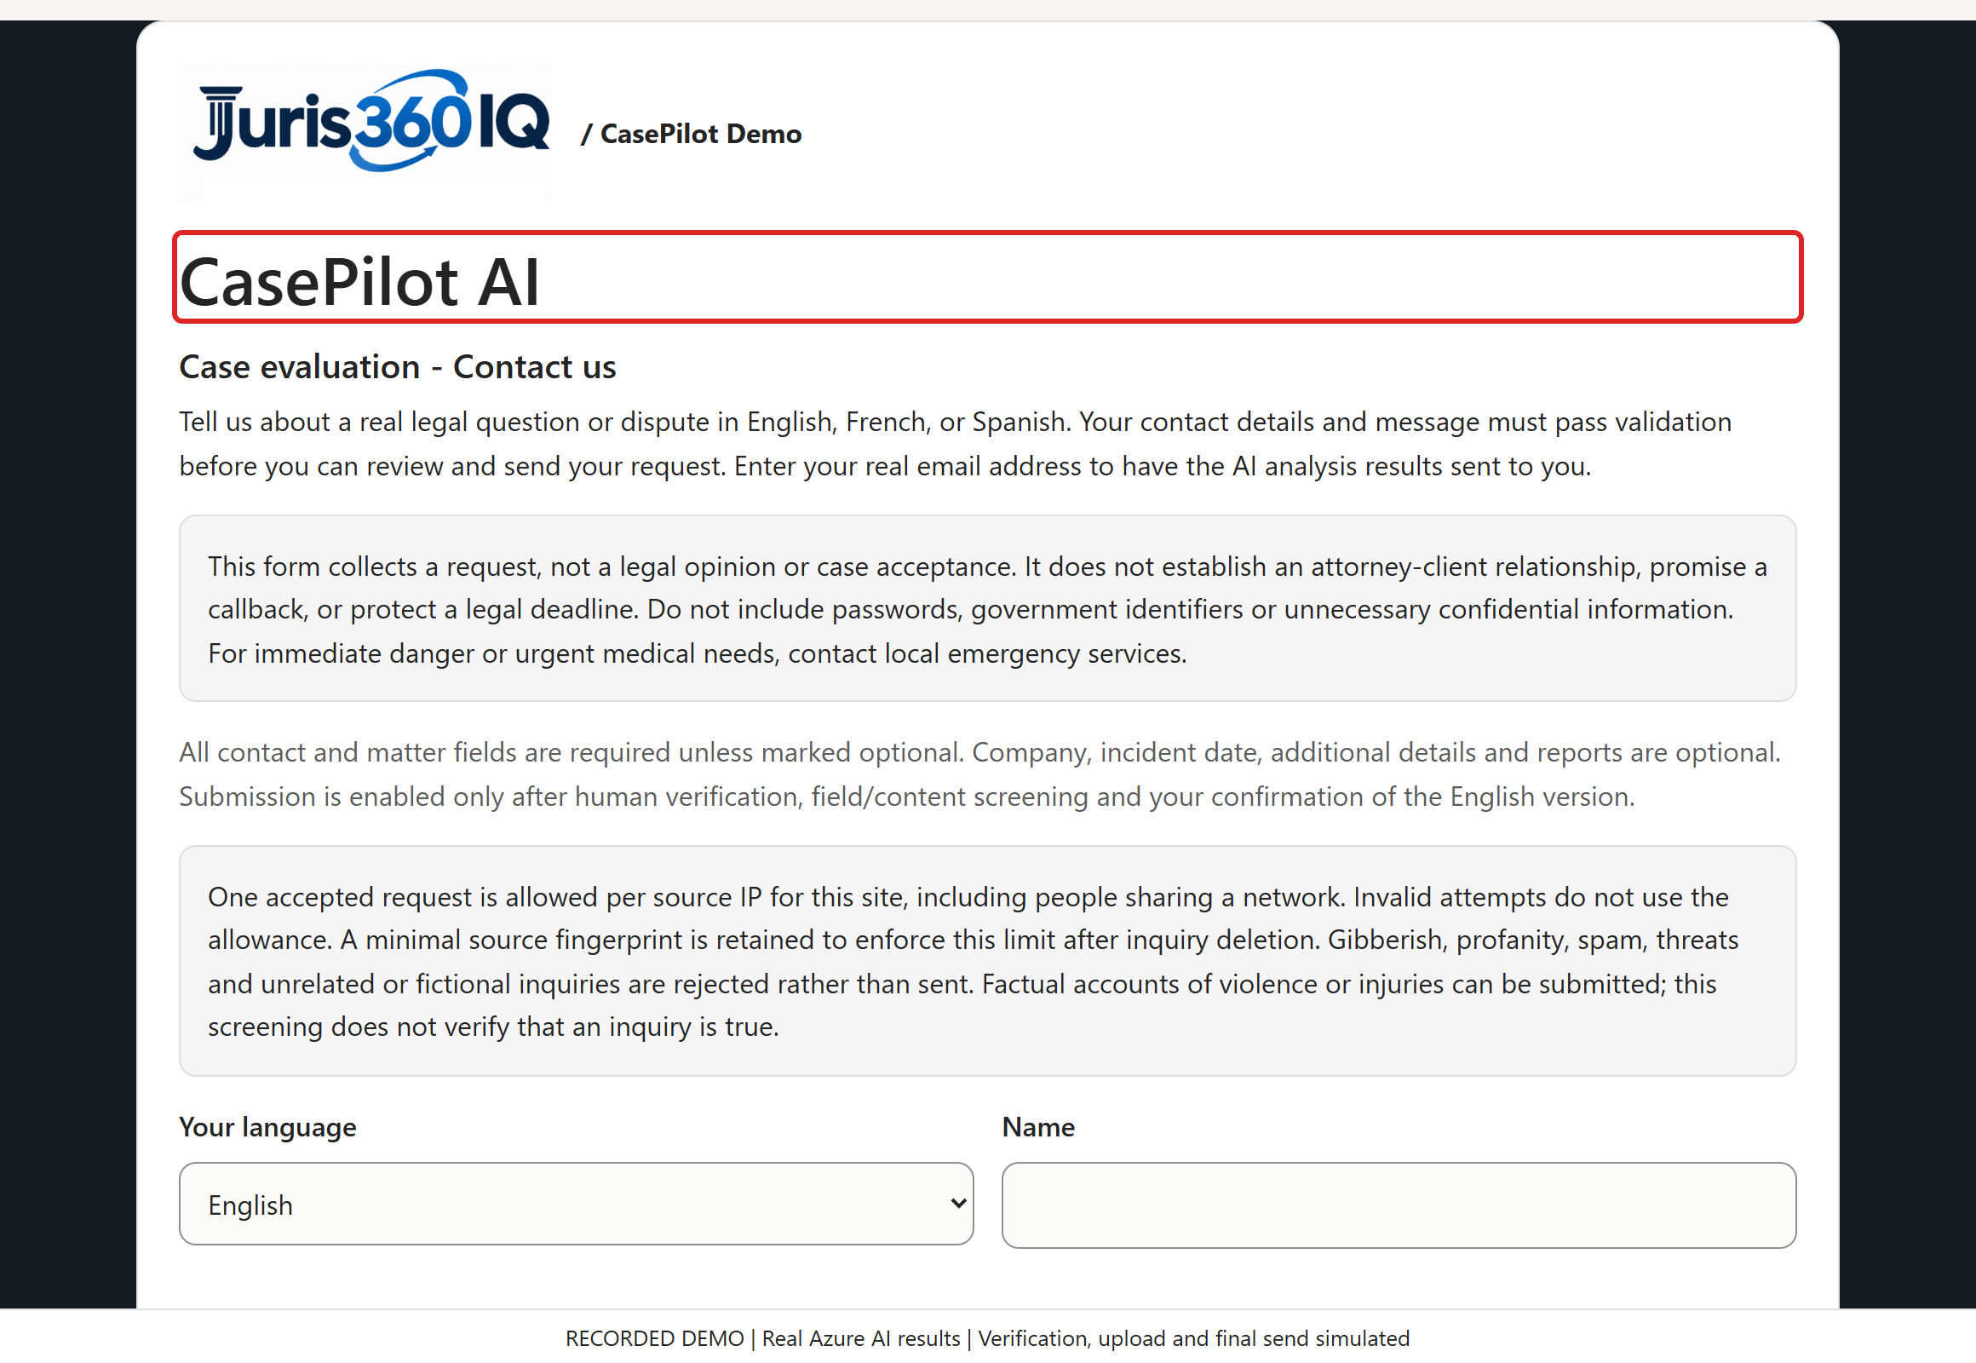
/ CASEPILOT DEMO
SCREEN 01 / 25
A guided, safer intake experience
ACTION / INPUT
Start with the CasePilot contact form. Review what the service does before entering information.
WHAT HAPPENS / WHY
The intake separates data-quality checks, contextual AI screening, evidence review and user confirmation.
VALUE TO A LAW FIRM
A consistent first-contact workflow can reduce repetitive intake work and make the next human review more focused.
Click Here
Recorded synthetic demo | Live Azure AI results | Verification, upload and final send simulated
Notes:
SCREEN 1: A guided, safer intake experience
ACTION: Start with the CasePilot contact form. Review what the service does before entering information.
WHAT HAPPENS: The intake separates data-quality checks, contextual AI screening, evidence review and user confirmation.
VALUE TO A LAW FIRM: A consistent first-contact workflow can reduce repetitive intake work and make the next human review more focused.
DEMO INTEGRITY: Local rejections use the real form JavaScript. AI fiction rejection, inquiry approval, summary and report classification are actual Azure outcomes captured 2026-10-22T20:01:04.6941892+00:00. UI processing replays those outcomes. Human verification, file transfer/malware scanning and final submission are simulated. No customer request, SQL record or email is created. All people and reports are fictional. Screening is not truth verification, legal advice, case acceptance or proof of report authenticity.

Slide 2
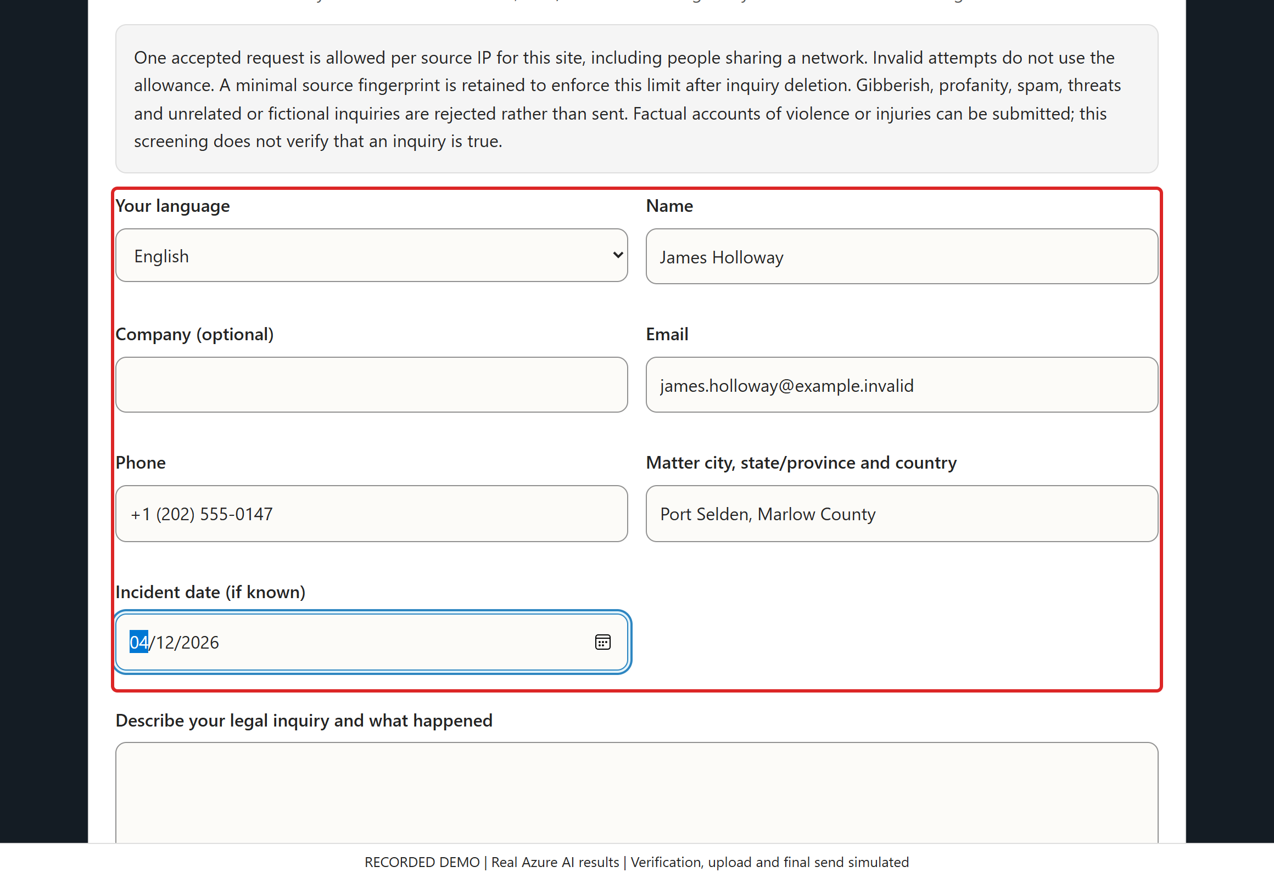
/ CASEPILOT DEMO
SCREEN 02 / 25
Enter clear contact and matter details
ACTION / INPUT
Enter James Holloway, a fictional email/phone, the matter location and April 12, 2026.
Click Here
WHAT HAPPENS / WHY
Required fields, email/phone formatting and date checks guide the user before a paid AI review.
VALUE TO A LAW FIRM
Structured fields reduce missing callback details and manual re-keying. A formatted address is not identity verification.
Recorded synthetic demo | Live Azure AI results | Verification, upload and final send simulated
Notes:
SCREEN 2: Enter clear contact and matter details
ACTION: Enter James Holloway, a fictional email/phone, the matter location and April 12, 2026.
WHAT HAPPENS: Required fields, email/phone formatting and date checks guide the user before a paid AI review.
VALUE TO A LAW FIRM: Structured fields reduce missing callback details and manual re-keying. A formatted address is not identity verification.
DEMO INTEGRITY: Local rejections use the real form JavaScript. AI fiction rejection, inquiry approval, summary and report classification are actual Azure outcomes captured 2026-10-22T20:01:04.6941892+00:00. UI processing replays those outcomes. Human verification, file transfer/malware scanning and final submission are simulated. No customer request, SQL record or email is created. All people and reports are fictional. Screening is not truth verification, legal advice, case acceptance or proof of report authenticity.

Slide 3
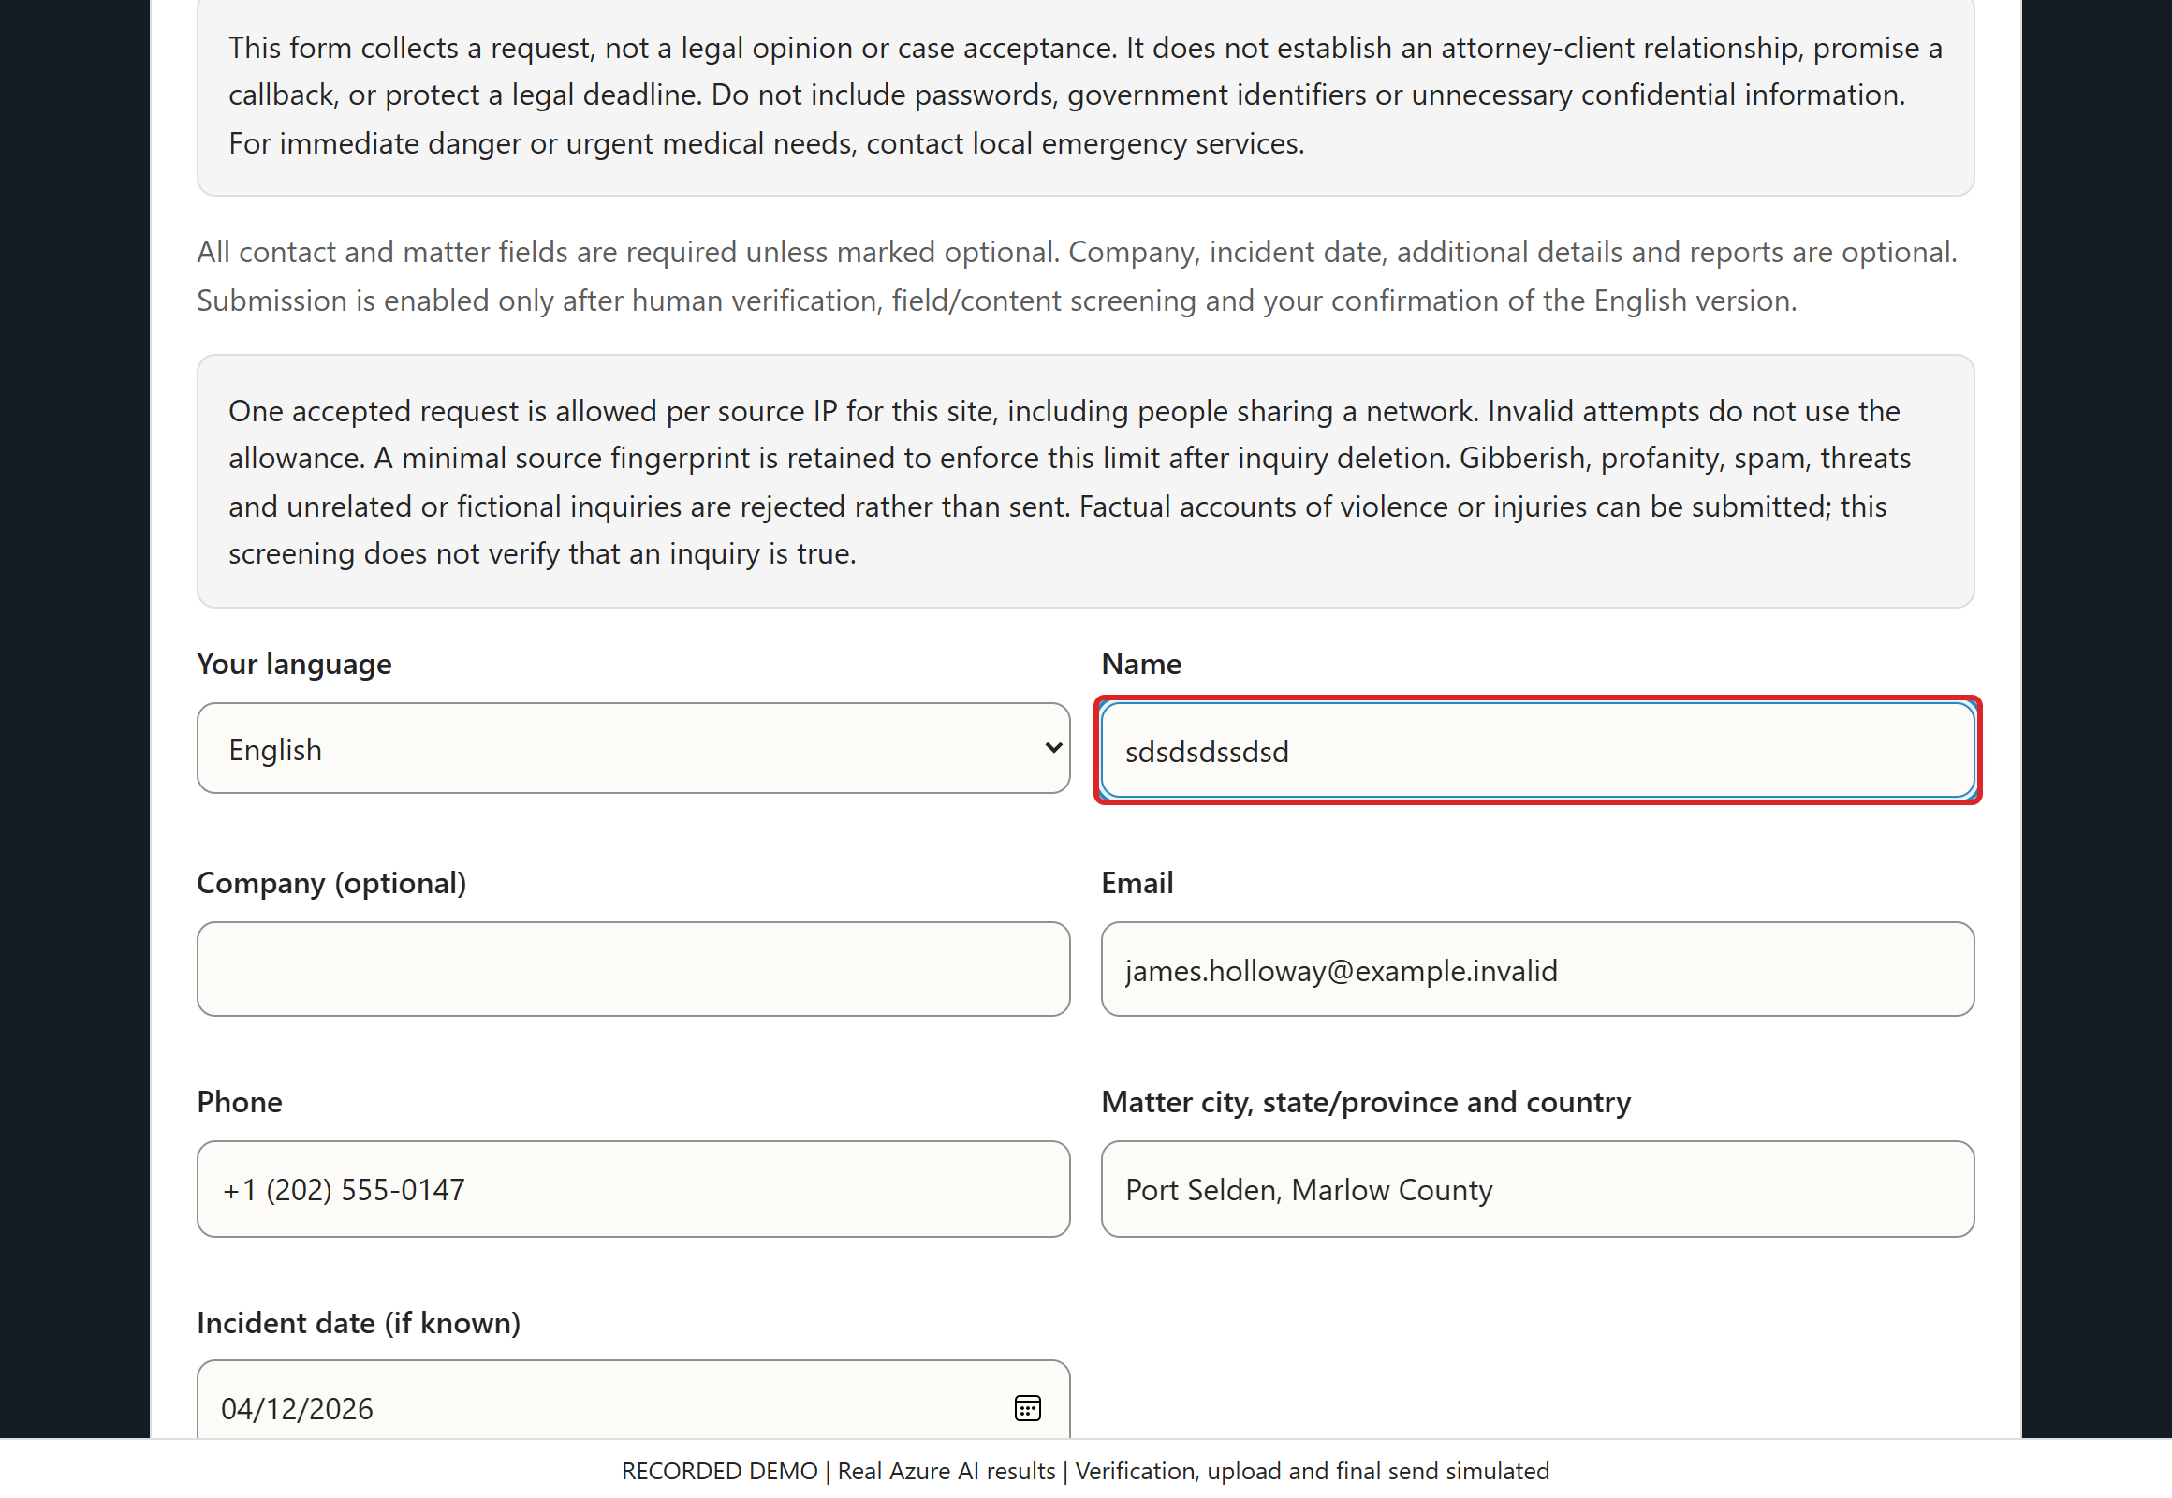
/ CASEPILOT DEMO
SCREEN 03 / 25
Test obvious keyboard gibberish
ACTION / INPUT
Type "sdsdsdssdsd" into Name, then pause or leave the field.
WHAT HAPPENS / WHY
The browser recognizes a narrow low-diversity keyboard-mashing pattern. This is not a judgment about unfamiliar names.
Click Here
VALUE TO A LAW FIRM
Cheap local checks keep obvious junk out of staff queues and avoid unnecessary AI calls.
Recorded synthetic demo | Live Azure AI results | Verification, upload and final send simulated
Notes:
SCREEN 3: Test obvious keyboard gibberish
ACTION: Type "sdsdsdssdsd" into Name, then pause or leave the field.
WHAT HAPPENS: The browser recognizes a narrow low-diversity keyboard-mashing pattern. This is not a judgment about unfamiliar names.
VALUE TO A LAW FIRM: Cheap local checks keep obvious junk out of staff queues and avoid unnecessary AI calls.
DEMO INTEGRITY: Local rejections use the real form JavaScript. AI fiction rejection, inquiry approval, summary and report classification are actual Azure outcomes captured 2026-10-22T20:01:04.6941892+00:00. UI processing replays those outcomes. Human verification, file transfer/malware scanning and final submission are simulated. No customer request, SQL record or email is created. All people and reports are fictional. Screening is not truth verification, legal advice, case acceptance or proof of report authenticity.

Slide 4
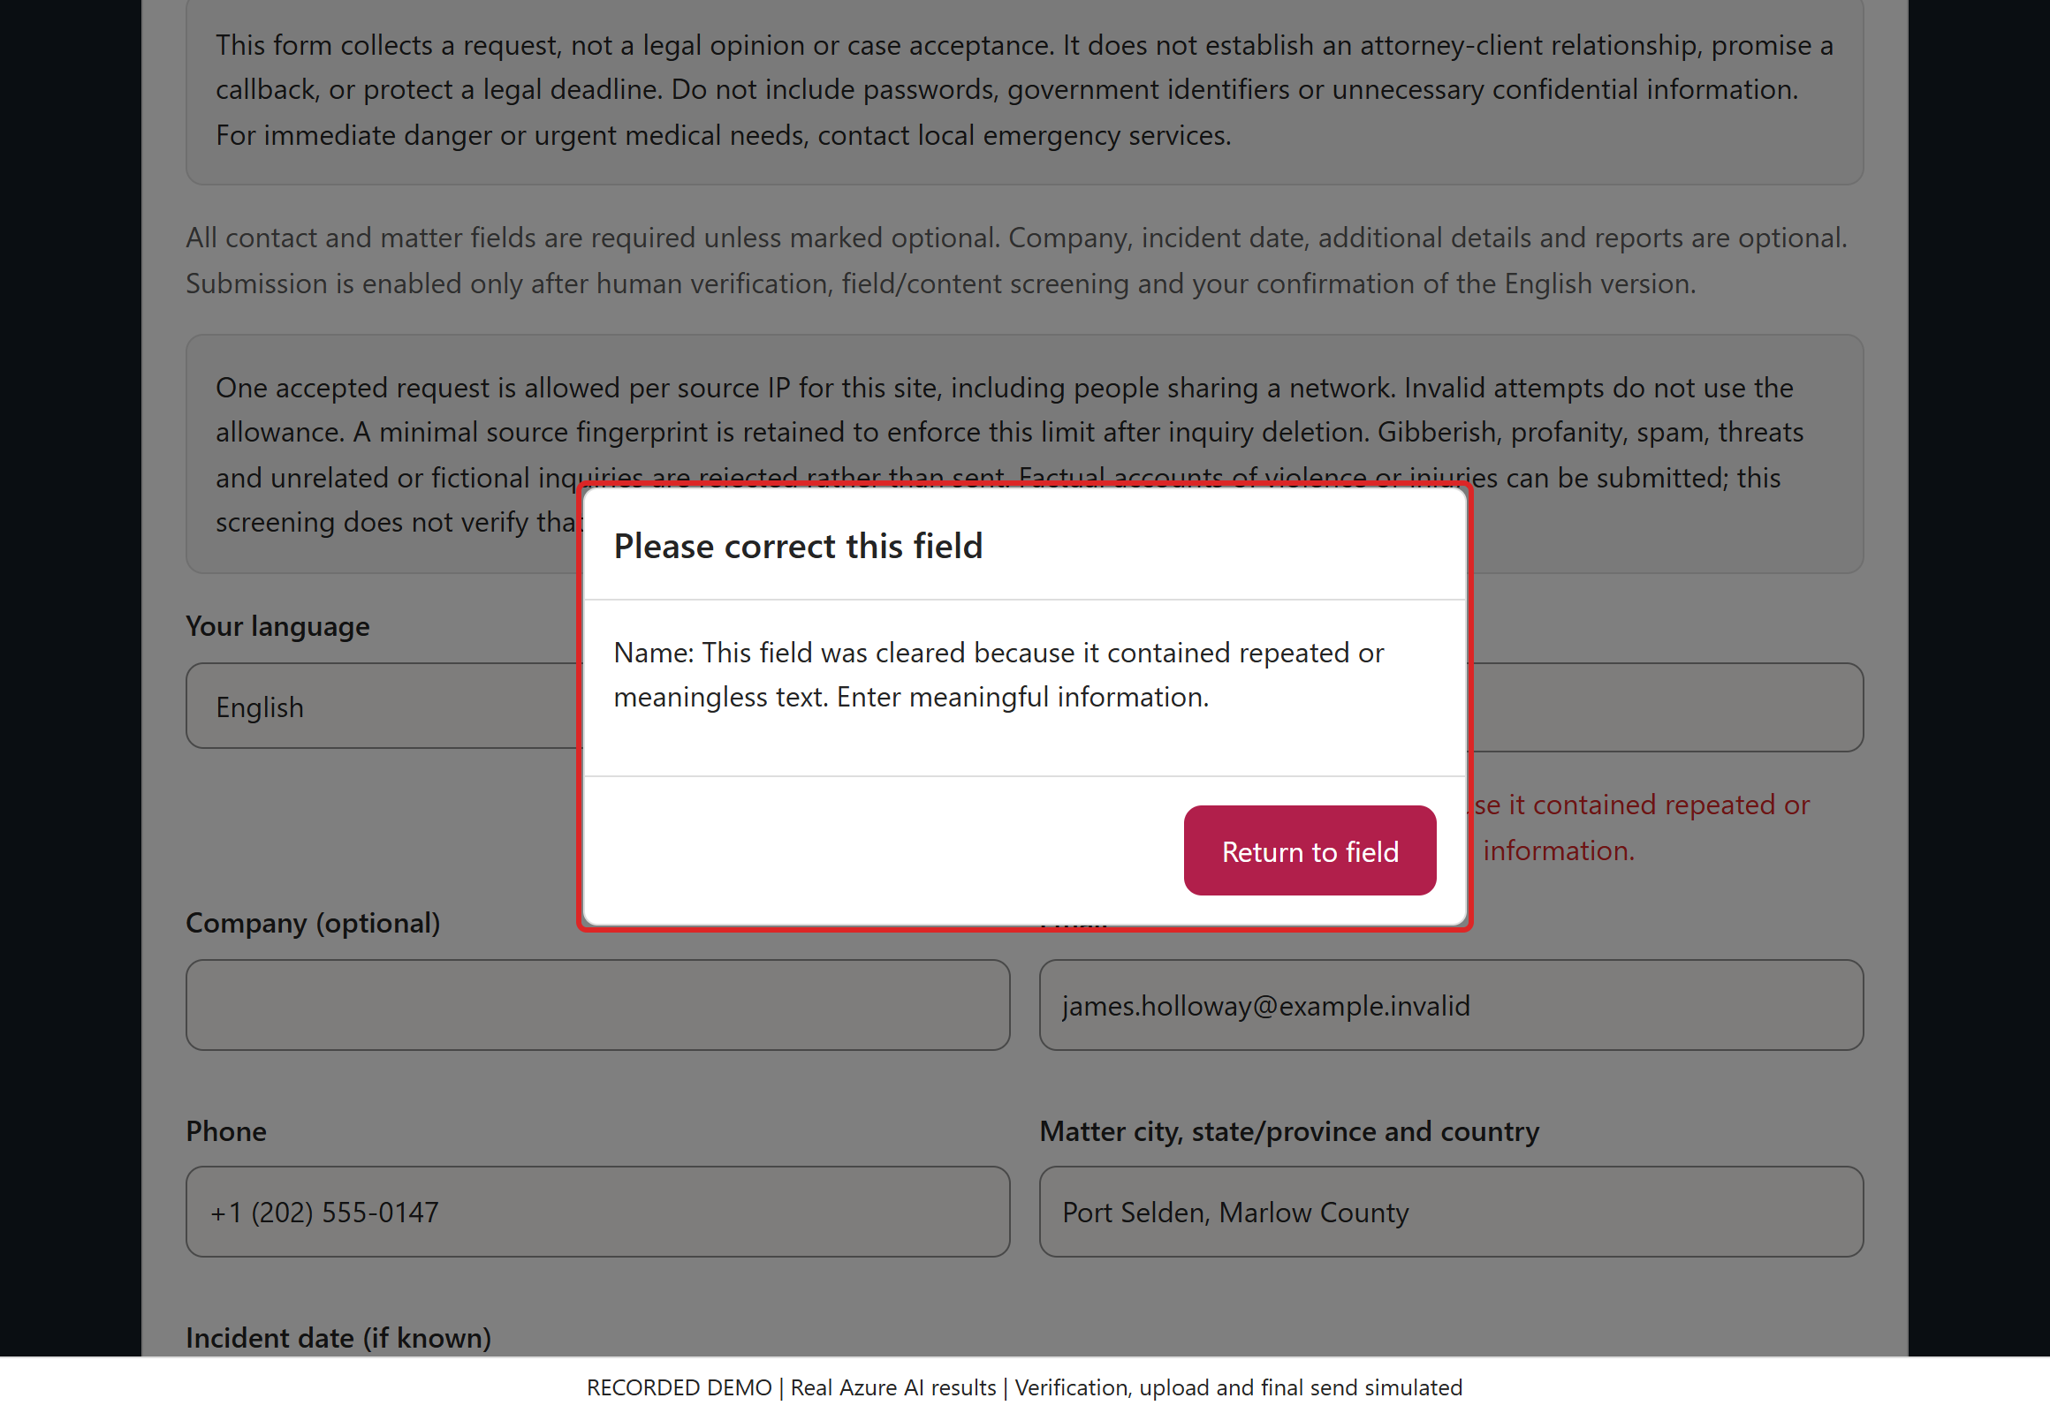
/ CASEPILOT DEMO
SCREEN 04 / 25
Explain why the input was cleared
ACTION / INPUT
Read the warning and click "Return to field".
WHAT HAPPENS / WHY
The Name field is cleared because its text matched an obvious meaningless-repetition rule. Other fields remain intact.
VALUE TO A LAW FIRM
Immediate, specific feedback lets a legitimate visitor correct the error without staff intervention.
Click Here
Recorded synthetic demo | Live Azure AI results | Verification, upload and final send simulated
Notes:
SCREEN 4: Explain why the input was cleared
ACTION: Read the warning and click "Return to field".
WHAT HAPPENS: The Name field is cleared because its text matched an obvious meaningless-repetition rule. Other fields remain intact.
VALUE TO A LAW FIRM: Immediate, specific feedback lets a legitimate visitor correct the error without staff intervention.
DEMO INTEGRITY: Local rejections use the real form JavaScript. AI fiction rejection, inquiry approval, summary and report classification are actual Azure outcomes captured 2026-10-22T20:01:04.6941892+00:00. UI processing replays those outcomes. Human verification, file transfer/malware scanning and final submission are simulated. No customer request, SQL record or email is created. All people and reports are fictional. Screening is not truth verification, legal advice, case acceptance or proof of report authenticity.

Slide 5
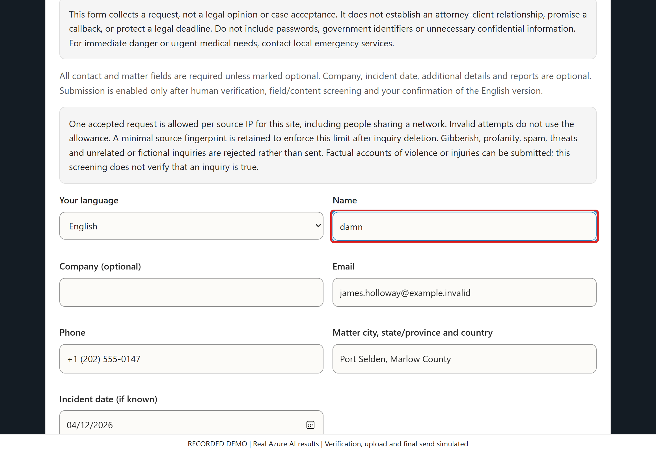
/ CASEPILOT DEMO
SCREEN 05 / 25
Test the respectful-language check
ACTION / INPUT
Enter "damn" in Name, then pause or leave the field.
WHAT HAPPENS / WHY
A shared normalized profanity rule runs locally. It matches words, not harmless substrings in names.
Click Here
VALUE TO A LAW FIRM
A clear language policy can reduce abusive intake noise while avoiding an AI charge for an obvious match.
Recorded synthetic demo | Live Azure AI results | Verification, upload and final send simulated
Notes:
SCREEN 5: Test the respectful-language check
ACTION: Enter "damn" in Name, then pause or leave the field.
WHAT HAPPENS: A shared normalized profanity rule runs locally. It matches words, not harmless substrings in names.
VALUE TO A LAW FIRM: A clear language policy can reduce abusive intake noise while avoiding an AI charge for an obvious match.
DEMO INTEGRITY: Local rejections use the real form JavaScript. AI fiction rejection, inquiry approval, summary and report classification are actual Azure outcomes captured 2026-10-22T20:01:04.6941892+00:00. UI processing replays those outcomes. Human verification, file transfer/malware scanning and final submission are simulated. No customer request, SQL record or email is created. All people and reports are fictional. Screening is not truth verification, legal advice, case acceptance or proof of report authenticity.

Slide 6
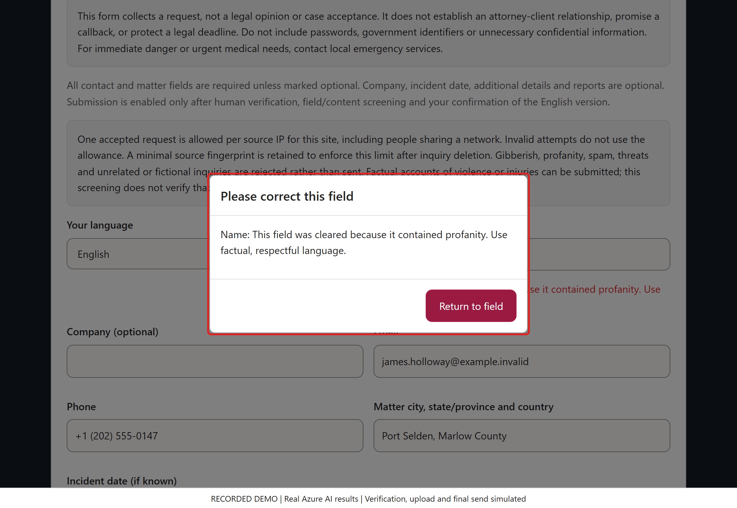
/ CASEPILOT DEMO
SCREEN 06 / 25
Reject profanity without echoing it
ACTION / INPUT
Review the profanity explanation, then click "Return to field" and restore James Holloway.
WHAT HAPPENS / WHY
Only the offending field clears. The popup explains the reason without copying the rejected text into the warning.
VALUE TO A LAW FIRM
Predictable feedback supports self-correction and prevents rejected text from becoming a saved inquiry.
Click Here
Recorded synthetic demo | Live Azure AI results | Verification, upload and final send simulated
Notes:
SCREEN 6: Reject profanity without echoing it
ACTION: Review the profanity explanation, then click "Return to field" and restore James Holloway.
WHAT HAPPENS: Only the offending field clears. The popup explains the reason without copying the rejected text into the warning.
VALUE TO A LAW FIRM: Predictable feedback supports self-correction and prevents rejected text from becoming a saved inquiry.
DEMO INTEGRITY: Local rejections use the real form JavaScript. AI fiction rejection, inquiry approval, summary and report classification are actual Azure outcomes captured 2026-10-22T20:01:04.6941892+00:00. UI processing replays those outcomes. Human verification, file transfer/malware scanning and final submission are simulated. No customer request, SQL record or email is created. All people and reports are fictional. Screening is not truth verification, legal advice, case acceptance or proof of report authenticity.

Slide 7
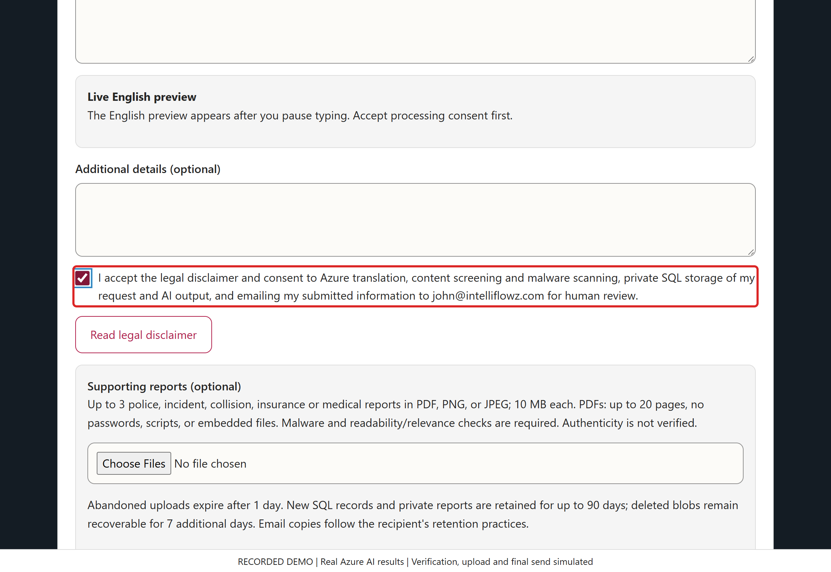
/ CASEPILOT DEMO
SCREEN 07 / 25
Explain processing and human verification
ACTION / INPUT
Read the disclaimer and check processing consent. Human verification is simulated for this recorded walkthrough.
WHAT HAPPENS / WHY
The live product requires consent and server-verified CAPTCHA before protected processing. The walkthrough cannot authorize a real request.
Click Here
VALUE TO A LAW FIRM
Clear disclosure supports informed participation and adds friction against automated abuse; CAPTCHA does not prove identity.
Recorded synthetic demo | Live Azure AI results | Verification, upload and final send simulated
Notes:
SCREEN 7: Explain processing and human verification
ACTION: Read the disclaimer and check processing consent. Human verification is simulated for this recorded walkthrough.
WHAT HAPPENS: The live product requires consent and server-verified CAPTCHA before protected processing. The walkthrough cannot authorize a real request.
VALUE TO A LAW FIRM: Clear disclosure supports informed participation and adds friction against automated abuse; CAPTCHA does not prove identity.
DEMO INTEGRITY: Local rejections use the real form JavaScript. AI fiction rejection, inquiry approval, summary and report classification are actual Azure outcomes captured 2026-10-22T20:01:04.6941892+00:00. UI processing replays those outcomes. Human verification, file transfer/malware scanning and final submission are simulated. No customer request, SQL record or email is created. All people and reports are fictional. Screening is not truth verification, legal advice, case acceptance or proof of report authenticity.

Slide 8
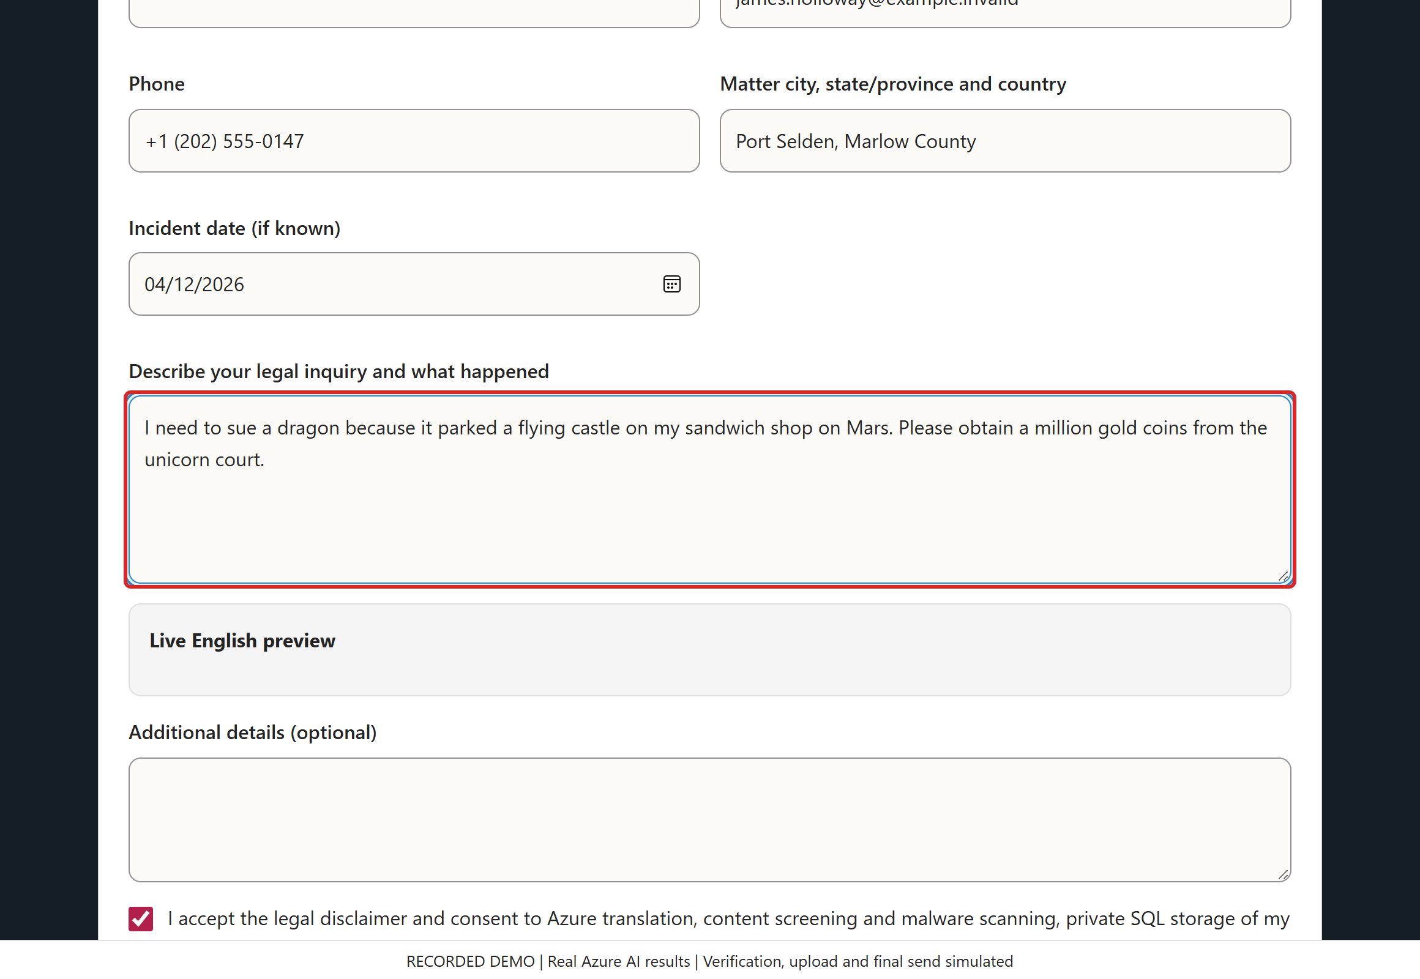
/ CASEPILOT DEMO
SCREEN 08 / 25
A well-written request can still be fiction
ACTION / INPUT
Enter the story about a dragon, a flying castle on Mars and a unicorn court. Pause for contextual screening.
WHAT HAPPENS / WHY
Click Here
The text is readable and passes basic length checks. Unlike keyboard junk, detecting its fictional subject requires semantic assessment.
VALUE TO A LAW FIRM
Contextual screening can spare a legal intake team time spent opening irrelevant or fabricated inquiries.
Recorded synthetic demo | Live Azure AI results | Verification, upload and final send simulated
Notes:
SCREEN 8: A well-written request can still be fiction
ACTION: Enter the story about a dragon, a flying castle on Mars and a unicorn court. Pause for contextual screening.
WHAT HAPPENS: The text is readable and passes basic length checks. Unlike keyboard junk, detecting its fictional subject requires semantic assessment.
VALUE TO A LAW FIRM: Contextual screening can spare a legal intake team time spent opening irrelevant or fabricated inquiries.
DEMO INTEGRITY: Local rejections use the real form JavaScript. AI fiction rejection, inquiry approval, summary and report classification are actual Azure outcomes captured 2026-10-22T20:01:04.6941892+00:00. UI processing replays those outcomes. Human verification, file transfer/malware scanning and final submission are simulated. No customer request, SQL record or email is created. All people and reports are fictional. Screening is not truth verification, legal advice, case acceptance or proof of report authenticity.

Slide 9
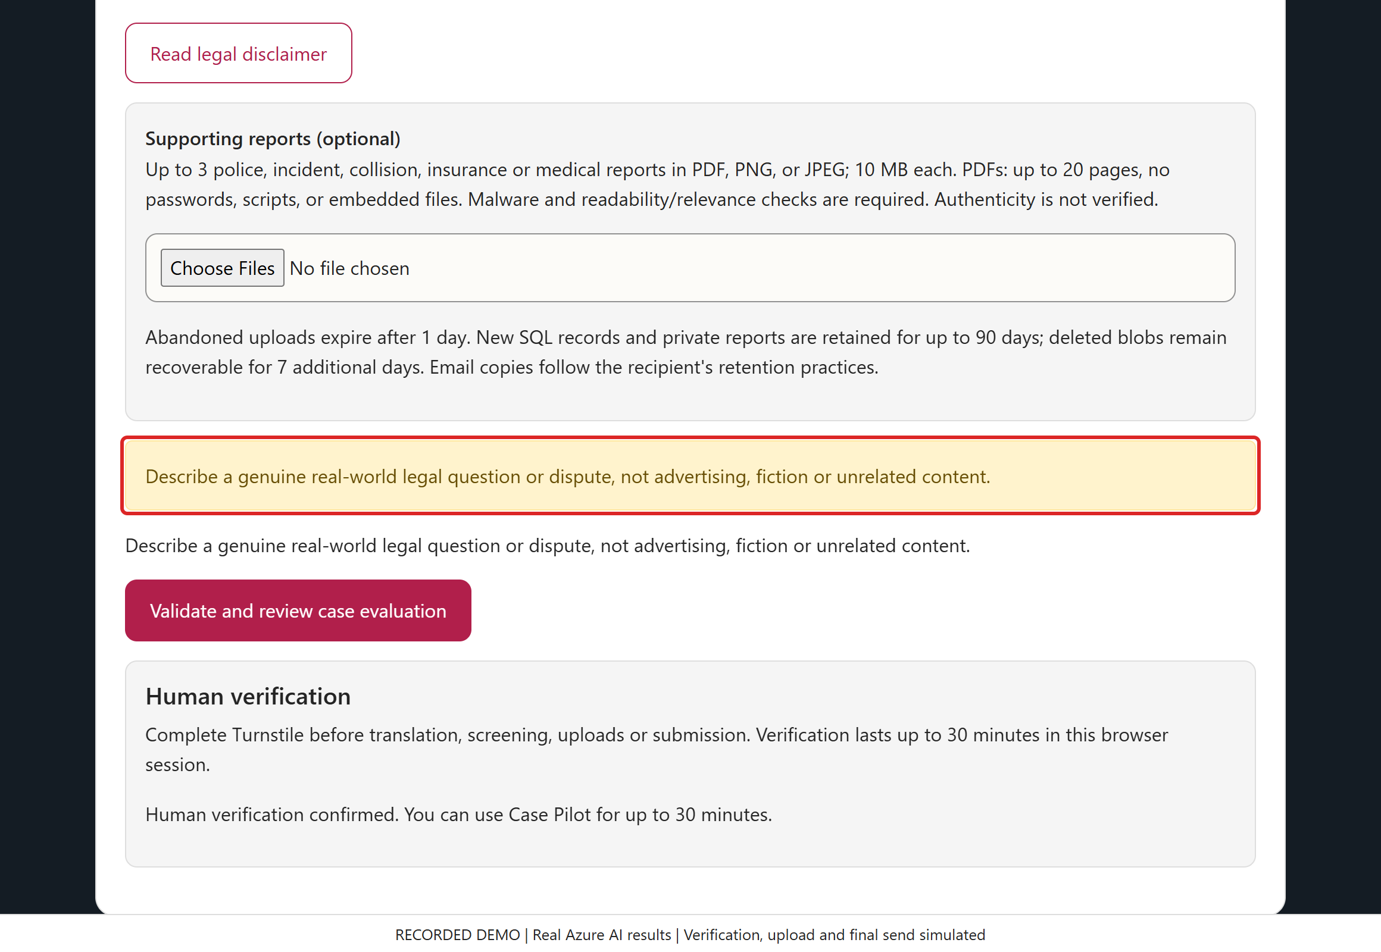
/ CASEPILOT DEMO
SCREEN 09 / 25
Azure rejects the fictional inquiry
ACTION / INPUT
Read the warning. Replace the fictional request with factual details; do not try to submit it.
WHAT HAPPENS / WHY
The actual Azure verdict was category fiction. The safe message asks for a genuine real-world legal question; no submission approval is issued.
VALUE TO A LAW FIRM
An explainable rejection helps the visitor understand the boundary while keeping unqualified noise out of the intake queue.
Click Here
Recorded synthetic demo | Live Azure AI results | Verification, upload and final send simulated
Notes:
SCREEN 9: Azure rejects the fictional inquiry
ACTION: Read the warning. Replace the fictional request with factual details; do not try to submit it.
WHAT HAPPENS: The actual Azure verdict was category fiction. The safe message asks for a genuine real-world legal question; no submission approval is issued.
VALUE TO A LAW FIRM: An explainable rejection helps the visitor understand the boundary while keeping unqualified noise out of the intake queue.
This is a live-generated AI outcome replayed in the browser, not a hard-coded claim about model accuracy.
DEMO INTEGRITY: Local rejections use the real form JavaScript. AI fiction rejection, inquiry approval, summary and report classification are actual Azure outcomes captured 2026-10-22T20:01:04.6941892+00:00. UI processing replays those outcomes. Human verification, file transfer/malware scanning and final submission are simulated. No customer request, SQL record or email is created. All people and reports are fictional. Screening is not truth verification, legal advice, case acceptance or proof of report authenticity.

Slide 10
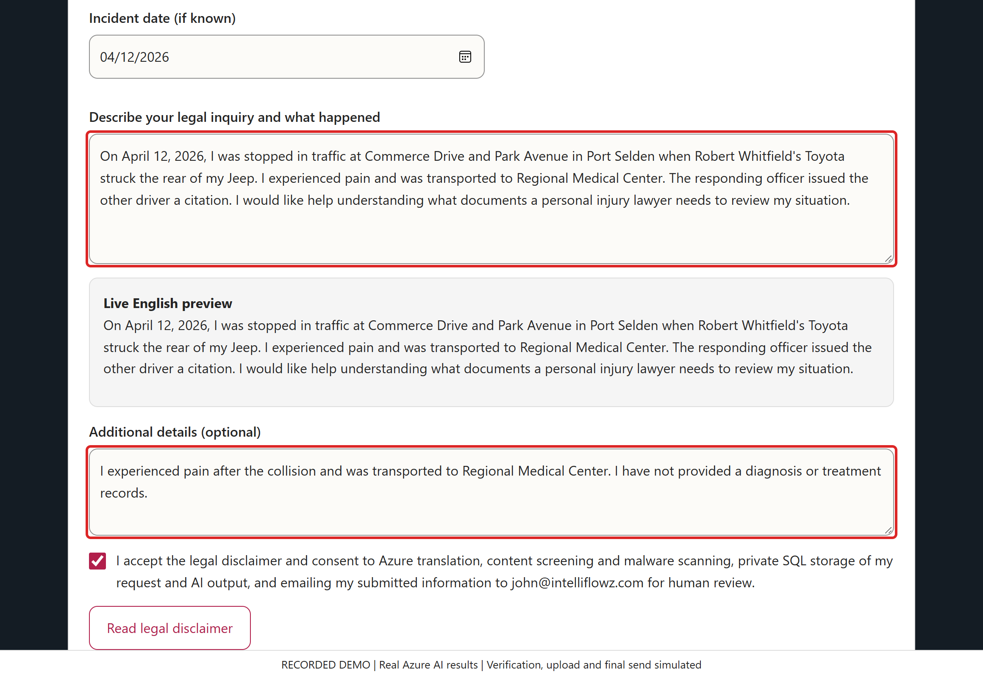
/ CASEPILOT DEMO
SCREEN 10 / 25
Describe a plausible legal matter
ACTION / INPUT
Enter the rear-end collision account and the reported pain/hospital transport, consistent with PR-001.
WHAT HAPPENS / WHY
The narrative states what the person reports and what assistance is sought. It does not invent a diagnosis, decide fault or promise a case.
VALUE TO A LAW FIRM
A clearer first account gives staff a useful starting point and makes missing evidence easier to identify.
Click Here
Recorded synthetic demo | Live Azure AI results | Verification, upload and final send simulated
Notes:
SCREEN 10: Describe a plausible legal matter
ACTION: Enter the rear-end collision account and the reported pain/hospital transport, consistent with PR-001.
WHAT HAPPENS: The narrative states what the person reports and what assistance is sought. It does not invent a diagnosis, decide fault or promise a case.
VALUE TO A LAW FIRM: A clearer first account gives staff a useful starting point and makes missing evidence easier to identify.
Although this represents a plausible real-world inquiry, every person and event in this demonstration is fictional.
DEMO INTEGRITY: Local rejections use the real form JavaScript. AI fiction rejection, inquiry approval, summary and report classification are actual Azure outcomes captured 2026-10-22T20:01:04.6941892+00:00. UI processing replays those outcomes. Human verification, file transfer/malware scanning and final submission are simulated. No customer request, SQL record or email is created. All people and reports are fictional. Screening is not truth verification, legal advice, case acceptance or proof of report authenticity.

Slide 11
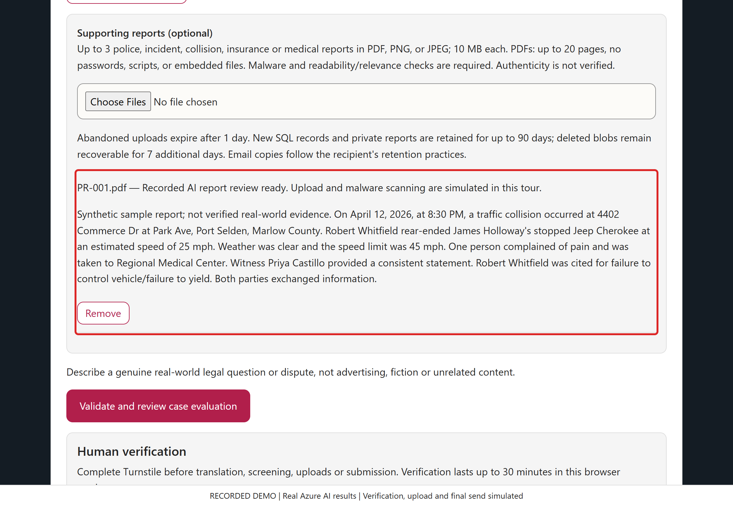
/ CASEPILOT DEMO
SCREEN 11 / 25
Associate the police report
ACTION / INPUT
Choose the supplied synthetic "PR-001.pdf" report. Review its recorded document classification and summary.
WHAT HAPPENS / WHY
Azure actually classified the PDF's extracted text as a police report. File transfer, quarantine and malware-scan completion are simulated in this tour.
VALUE TO A LAW FIRM
Evidence metadata and a concise report summary can reduce document opening and manual triage. They do not certify authenticity.
Click Here
Recorded synthetic demo | Live Azure AI results | Verification, upload and final send simulated
Notes:
SCREEN 11: Associate the police report
ACTION: Choose the supplied synthetic "PR-001.pdf" report. Review its recorded document classification and summary.
WHAT HAPPENS: Azure actually classified the PDF's extracted text as a police report. File transfer, quarantine and malware-scan completion are simulated in this tour.
VALUE TO A LAW FIRM: Evidence metadata and a concise report summary can reduce document opening and manual triage. They do not certify authenticity.
DEMO INTEGRITY: Local rejections use the real form JavaScript. AI fiction rejection, inquiry approval, summary and report classification are actual Azure outcomes captured 2026-10-22T20:01:04.6941892+00:00. UI processing replays those outcomes. Human verification, file transfer/malware scanning and final submission are simulated. No customer request, SQL record or email is created. All people and reports are fictional. Screening is not truth verification, legal advice, case acceptance or proof of report authenticity.

Slide 12
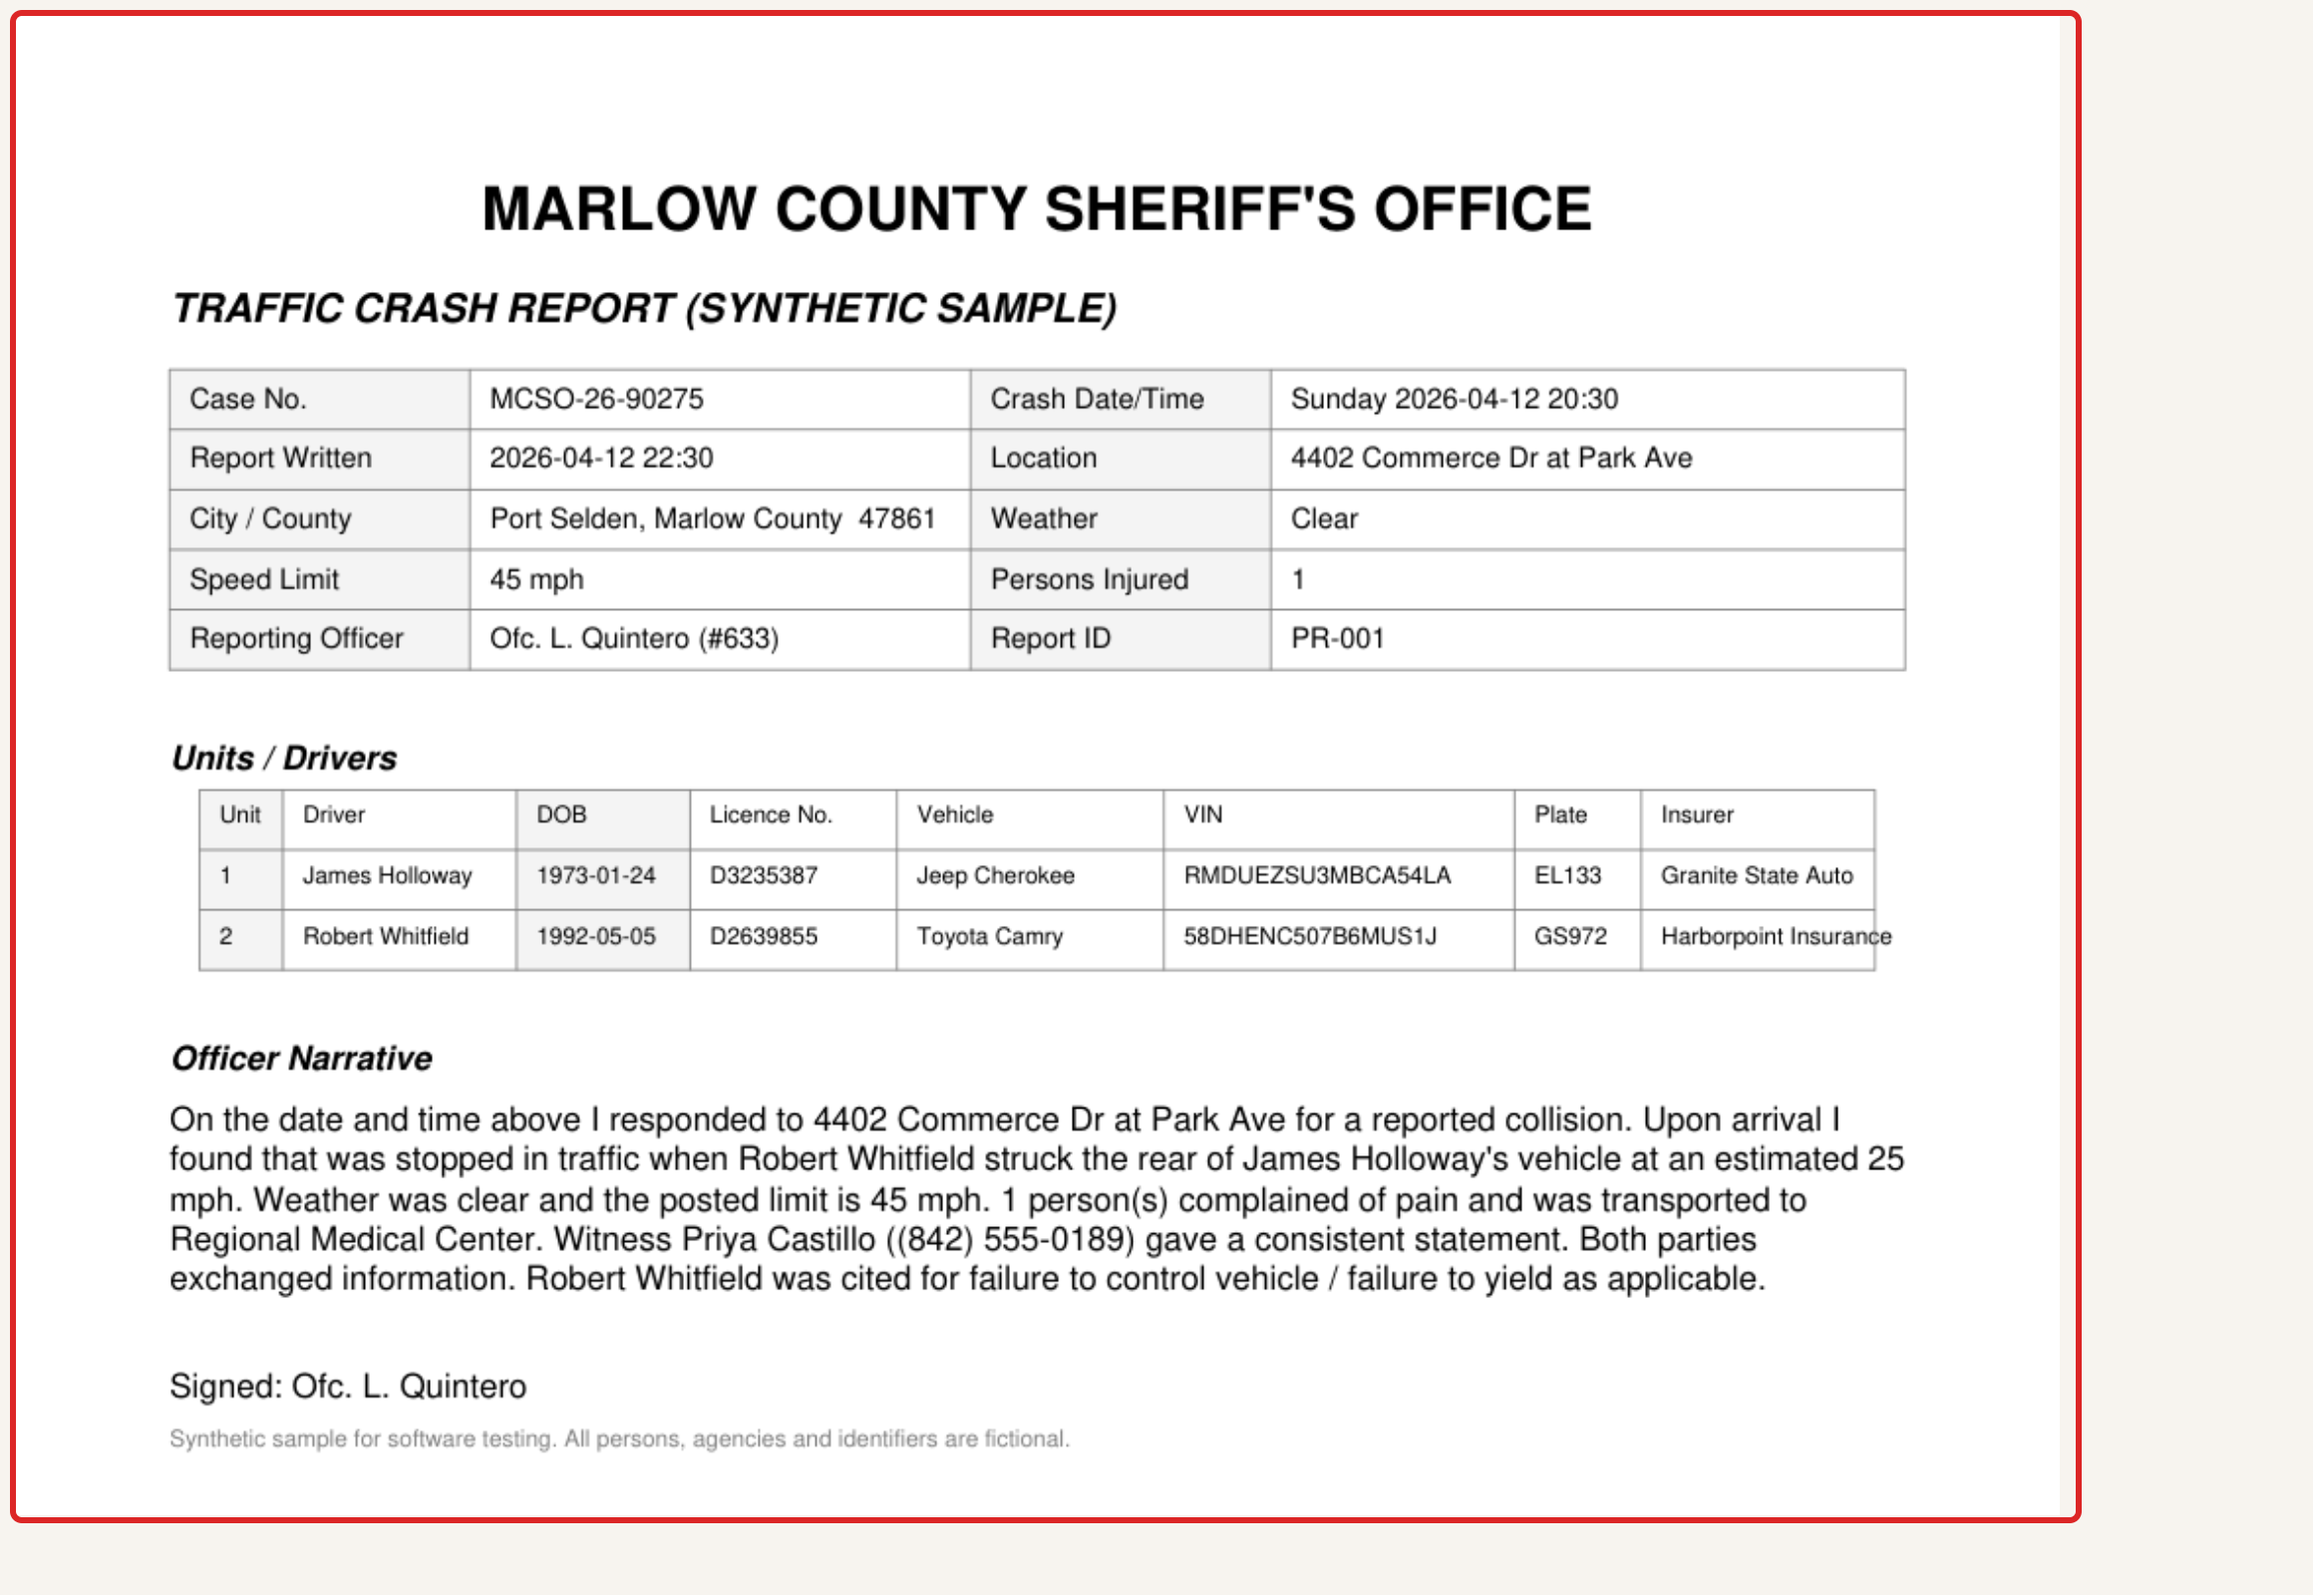
/ CASEPILOT DEMO
SCREEN 12 / 25
Read the source, not just the summary
ACTION / INPUT
Open PR-001 and compare the incident date, parties and officer narrative with the inquiry.
WHAT HAPPENS / WHY
The report is explicitly labeled a synthetic sample. A citation is reported evidence, not a final determination of civil liability.
VALUE TO A LAW FIRM
Source-to-summary comparison helps lawyers spot gaps and discrepancies rather than relying blindly on an AI-generated narrative.
Click Here
Recorded synthetic demo | Live Azure AI results | Verification, upload and final send simulated
Notes:
SCREEN 12: Read the source, not just the summary
ACTION: Open PR-001 and compare the incident date, parties and officer narrative with the inquiry.
WHAT HAPPENS: The report is explicitly labeled a synthetic sample. A citation is reported evidence, not a final determination of civil liability.
VALUE TO A LAW FIRM: Source-to-summary comparison helps lawyers spot gaps and discrepancies rather than relying blindly on an AI-generated narrative.
The actual local sample PDF is supplied with this walkthrough for inspection.
DEMO INTEGRITY: Local rejections use the real form JavaScript. AI fiction rejection, inquiry approval, summary and report classification are actual Azure outcomes captured 2026-10-22T20:01:04.6941892+00:00. UI processing replays those outcomes. Human verification, file transfer/malware scanning and final submission are simulated. No customer request, SQL record or email is created. All people and reports are fictional. Screening is not truth verification, legal advice, case acceptance or proof of report authenticity.

Slide 13
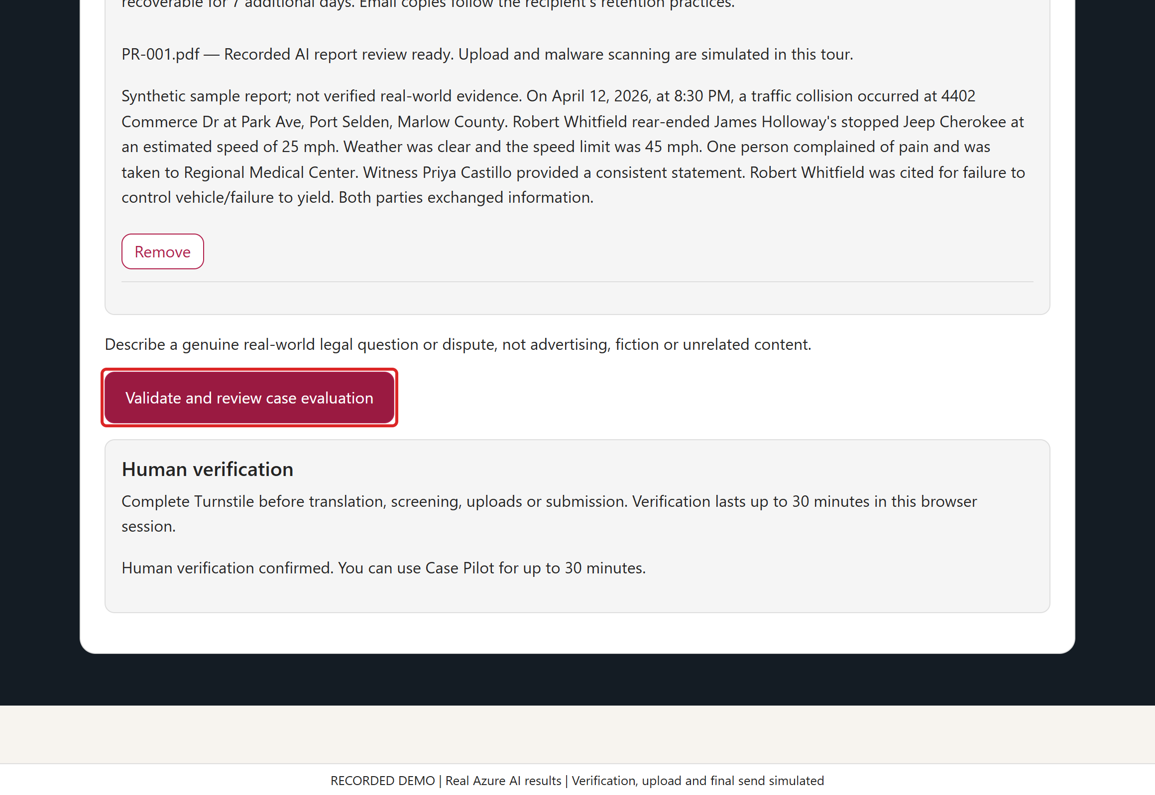
/ CASEPILOT DEMO
SCREEN 13 / 25
Request the English review and AI summary
ACTION / INPUT
Click "Validate and review case evaluation" after the required fields and report are ready.
WHAT HAPPENS / WHY
In the live product this gates full screening, approved English and an independently checked lawyer brief combining the inquiry with the screened report.
Click Here
VALUE TO A LAW FIRM
Standardizing the intake package can reduce transcription errors and make the next handoff more consistent.
Recorded synthetic demo | Live Azure AI results | Verification, upload and final send simulated
Notes:
SCREEN 13: Request the English review and AI summary
ACTION: Click "Validate and review case evaluation" after the required fields and report are ready.
WHAT HAPPENS: In the live product this gates full screening, approved English and an independently checked lawyer brief combining the inquiry with the screened report.
VALUE TO A LAW FIRM: Standardizing the intake package can reduce transcription errors and make the next handoff more consistent.
DEMO INTEGRITY: Local rejections use the real form JavaScript. AI fiction rejection, inquiry approval, summary and report classification are actual Azure outcomes captured 2026-10-22T20:01:04.6941892+00:00. UI processing replays those outcomes. Human verification, file transfer/malware scanning and final submission are simulated. No customer request, SQL record or email is created. All people and reports are fictional. Screening is not truth verification, legal advice, case acceptance or proof of report authenticity.

Slide 14
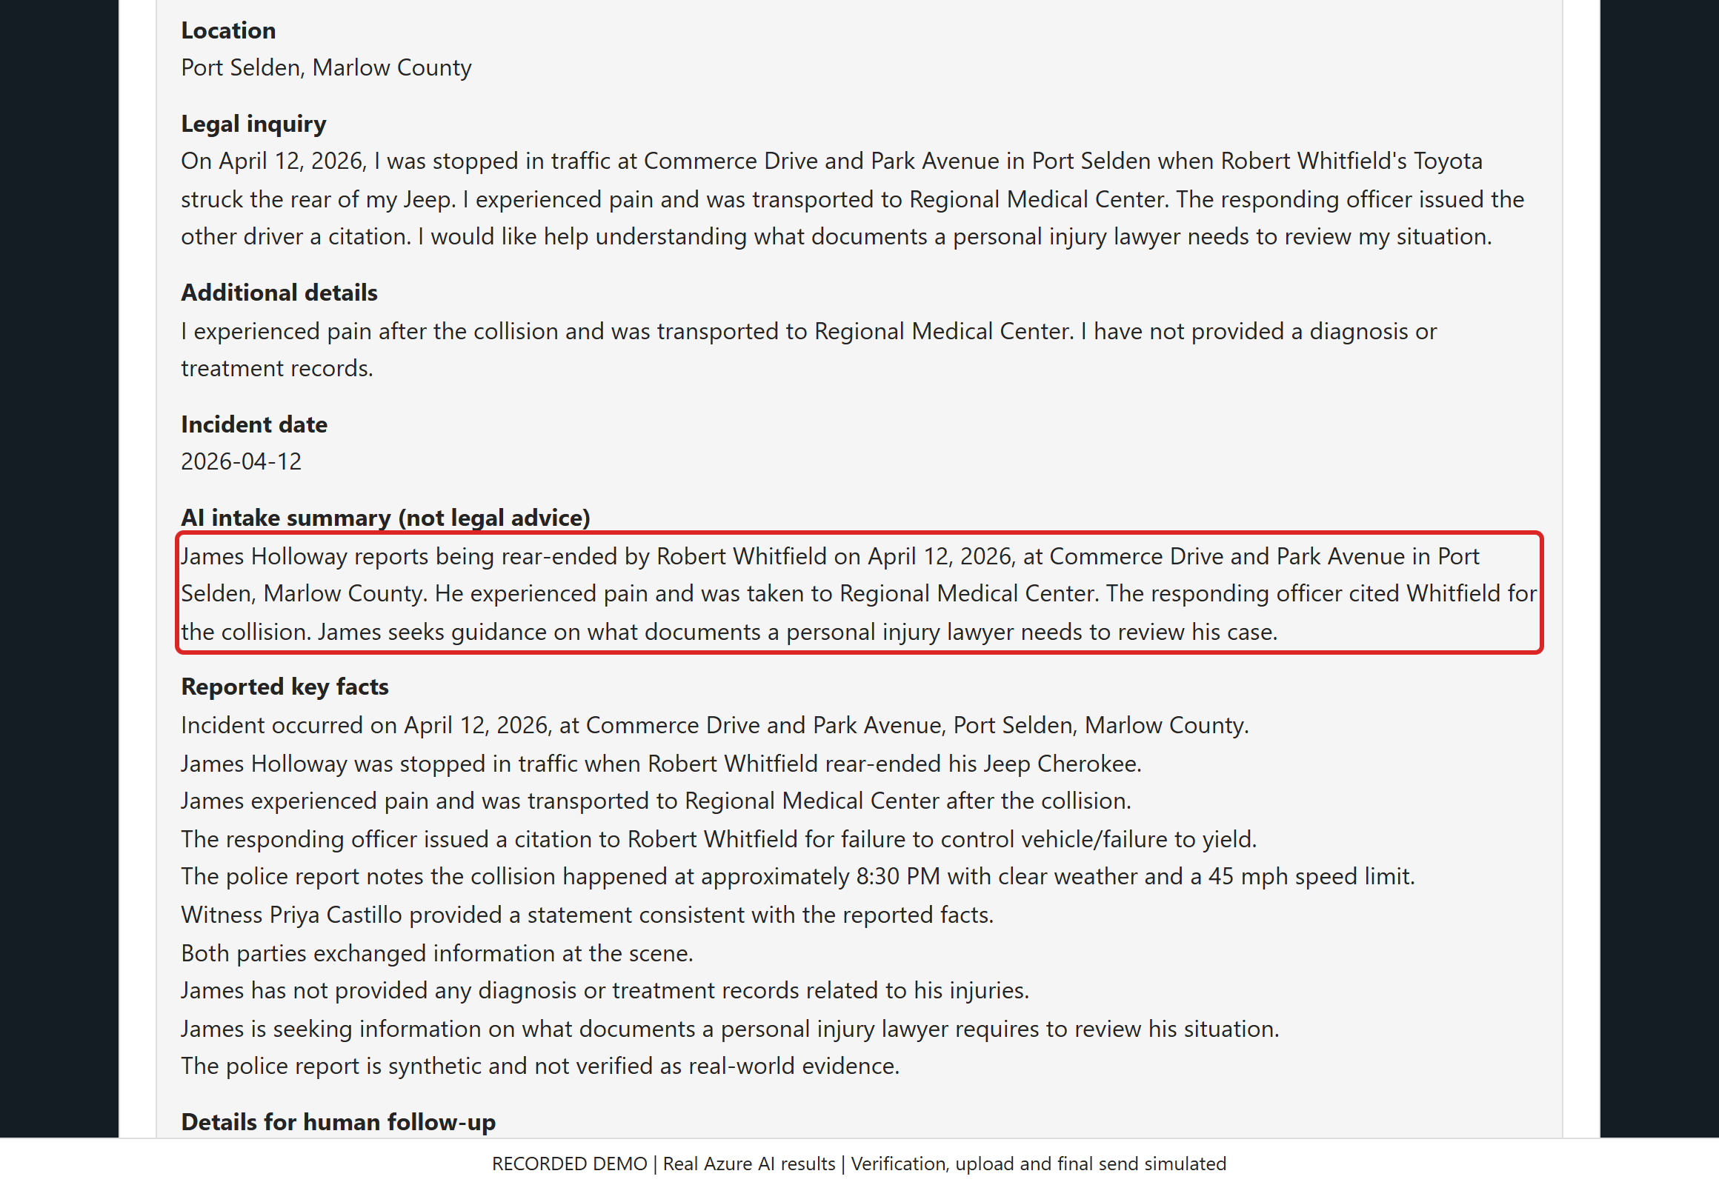
/ CASEPILOT DEMO
SCREEN 14 / 25
Review the AI-generated intake analysis
ACTION / INPUT
Read the AI inquiry summary. The later full-email preview preserves every reported fact and the complete combined assessment.
WHAT HAPPENS / WHY
The AI combines the account with report details while keeping diagnoses and treatment unknown instead of inventing them.
VALUE TO A LAW FIRM
An evidence-oriented summary can reduce initial reading time and help staff ask more focused follow-up questions. A lawyer must still verify the facts.
Click Here
Recorded synthetic demo | Live Azure AI results | Verification, upload and final send simulated
Notes:
SCREEN 14: Review the AI-generated intake analysis
ACTION: Read the AI inquiry summary. The later full-email preview preserves every reported fact and the complete combined assessment.
WHAT HAPPENS: The AI combines the account with report details while keeping diagnoses and treatment unknown instead of inventing them.
VALUE TO A LAW FIRM: An evidence-oriented summary can reduce initial reading time and help staff ask more focused follow-up questions. A lawyer must still verify the facts.
The analysis shown is the actual captured Azure result. It is not a merits opinion, liability finding or representation decision.
DEMO INTEGRITY: Local rejections use the real form JavaScript. AI fiction rejection, inquiry approval, summary and report classification are actual Azure outcomes captured 2026-10-22T20:01:04.6941892+00:00. UI processing replays those outcomes. Human verification, file transfer/malware scanning and final submission are simulated. No customer request, SQL record or email is created. All people and reports are fictional. Screening is not truth verification, legal advice, case acceptance or proof of report authenticity.

Slide 15
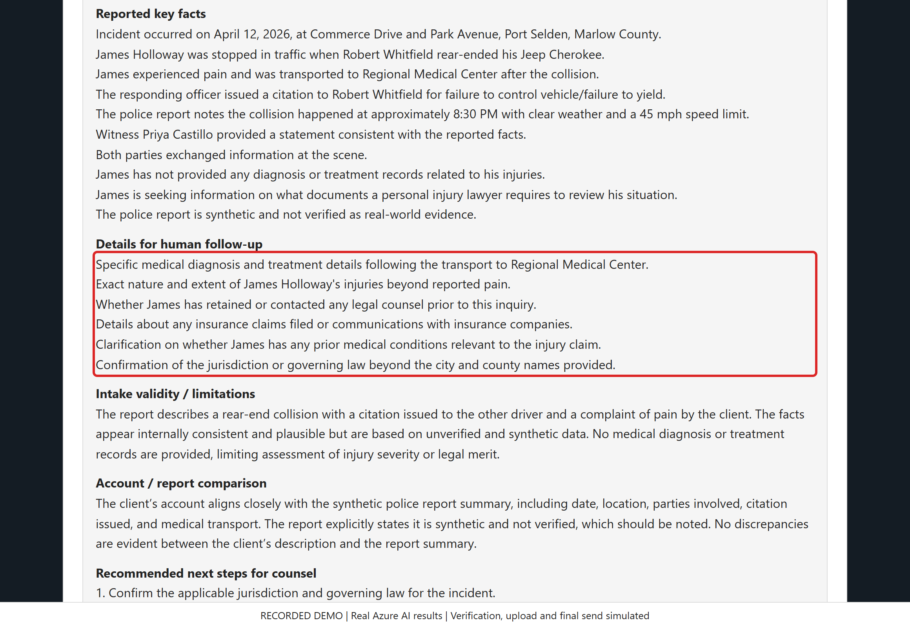
/ CASEPILOT DEMO
SCREEN 15 / 25
Turn missing details into focused follow-up
ACTION / INPUT
Read the complete follow-up checklist before confirming the request.
WHAT HAPPENS / WHY
The AI flags medical records, insurance, prior counsel, relevant history and jurisdiction for follow-up, rather than treating them as established facts.
VALUE TO A LAW FIRM
A focused checklist can reduce back-and-forth and help an intake team prepare a more complete file for the lawyer.
Click Here
Recorded synthetic demo | Live Azure AI results | Verification, upload and final send simulated
Notes:
SCREEN 15: Turn missing details into focused follow-up
ACTION: Read the complete follow-up checklist before confirming the request.
WHAT HAPPENS: The AI flags medical records, insurance, prior counsel, relevant history and jurisdiction for follow-up, rather than treating them as established facts.
VALUE TO A LAW FIRM: A focused checklist can reduce back-and-forth and help an intake team prepare a more complete file for the lawyer.
This is an administrative follow-up aid. It does not set legal deadlines or determine whether a claim should be accepted.
DEMO INTEGRITY: Local rejections use the real form JavaScript. AI fiction rejection, inquiry approval, summary and report classification are actual Azure outcomes captured 2026-10-22T20:01:04.6941892+00:00. UI processing replays those outcomes. Human verification, file transfer/malware scanning and final submission are simulated. No customer request, SQL record or email is created. All people and reports are fictional. Screening is not truth verification, legal advice, case acceptance or proof of report authenticity.

Slide 16
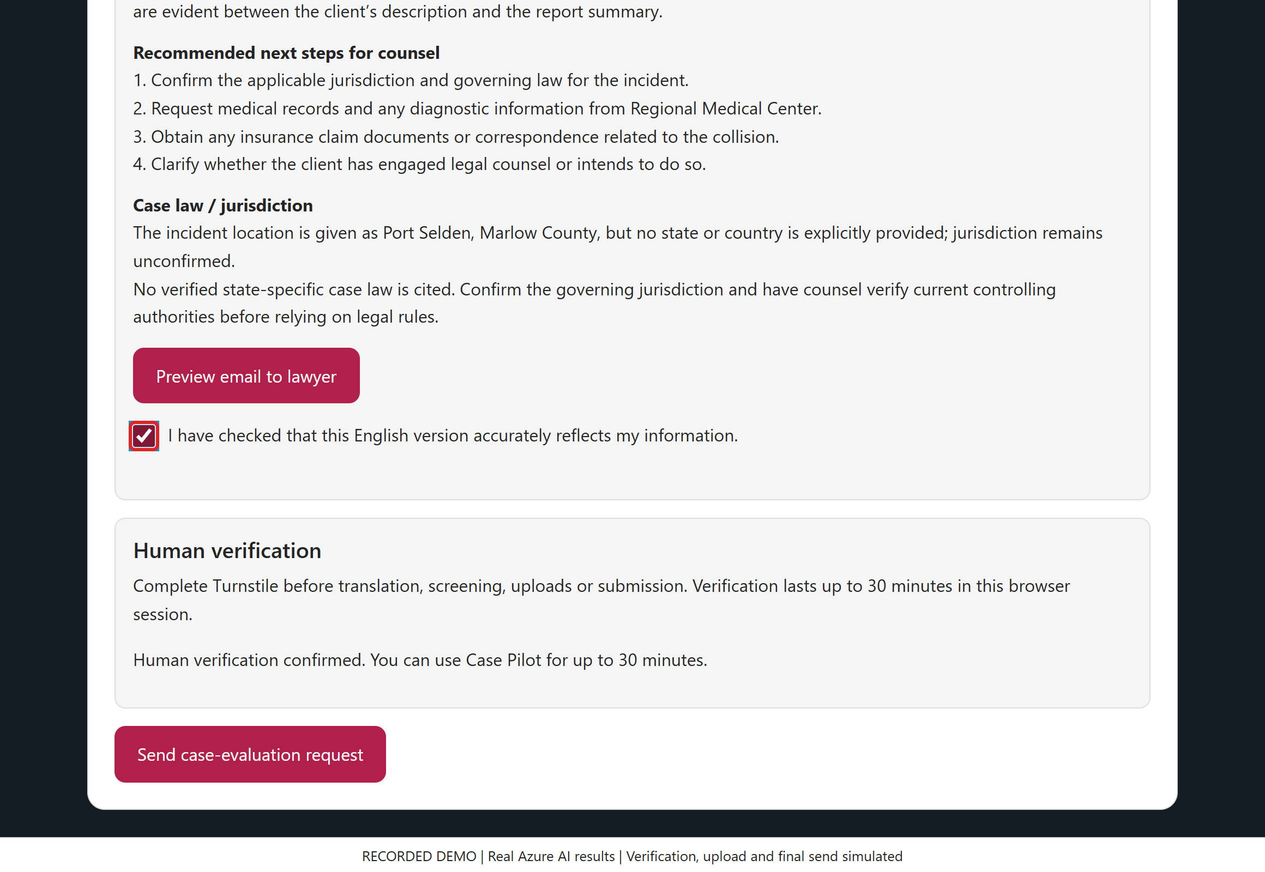
/ CASEPILOT DEMO
SCREEN 16 / 25
Keep the user in control of the handoff
ACTION / INPUT
Check that the English version is accurate. Preview the complete lawyer email before the final simulated send.
WHAT HAPPENS / WHY
Confirmation is required before sending; edits revoke prior approval. The next screens show the actual combined analysis and full proposed email, without sending it.
VALUE TO A LAW FIRM
Explicit confirmation catches misunderstandings before handoff and preserves accountability for the information submitted.
Click Here
Recorded synthetic demo | Live Azure AI results | Verification, upload and final send simulated
Notes:
SCREEN 16: Keep the user in control of the handoff
ACTION: Check that the English version is accurate. Preview the complete lawyer email before the final simulated send.
WHAT HAPPENS: Confirmation is required before sending; edits revoke prior approval. The next screens show the actual combined analysis and full proposed email, without sending it.
VALUE TO A LAW FIRM: Explicit confirmation catches misunderstandings before handoff and preserves accountability for the information submitted.
In the real configured workflow a successful submit persists the original fields, approved English, AI results and usage in SQL before acknowledging success.
DEMO INTEGRITY: Local rejections use the real form JavaScript. AI fiction rejection, inquiry approval, summary and report classification are actual Azure outcomes captured 2026-10-22T20:01:04.6941892+00:00. UI processing replays those outcomes. Human verification, file transfer/malware scanning and final submission are simulated. No customer request, SQL record or email is created. All people and reports are fictional. Screening is not truth verification, legal advice, case acceptance or proof of report authenticity.

Slide 17
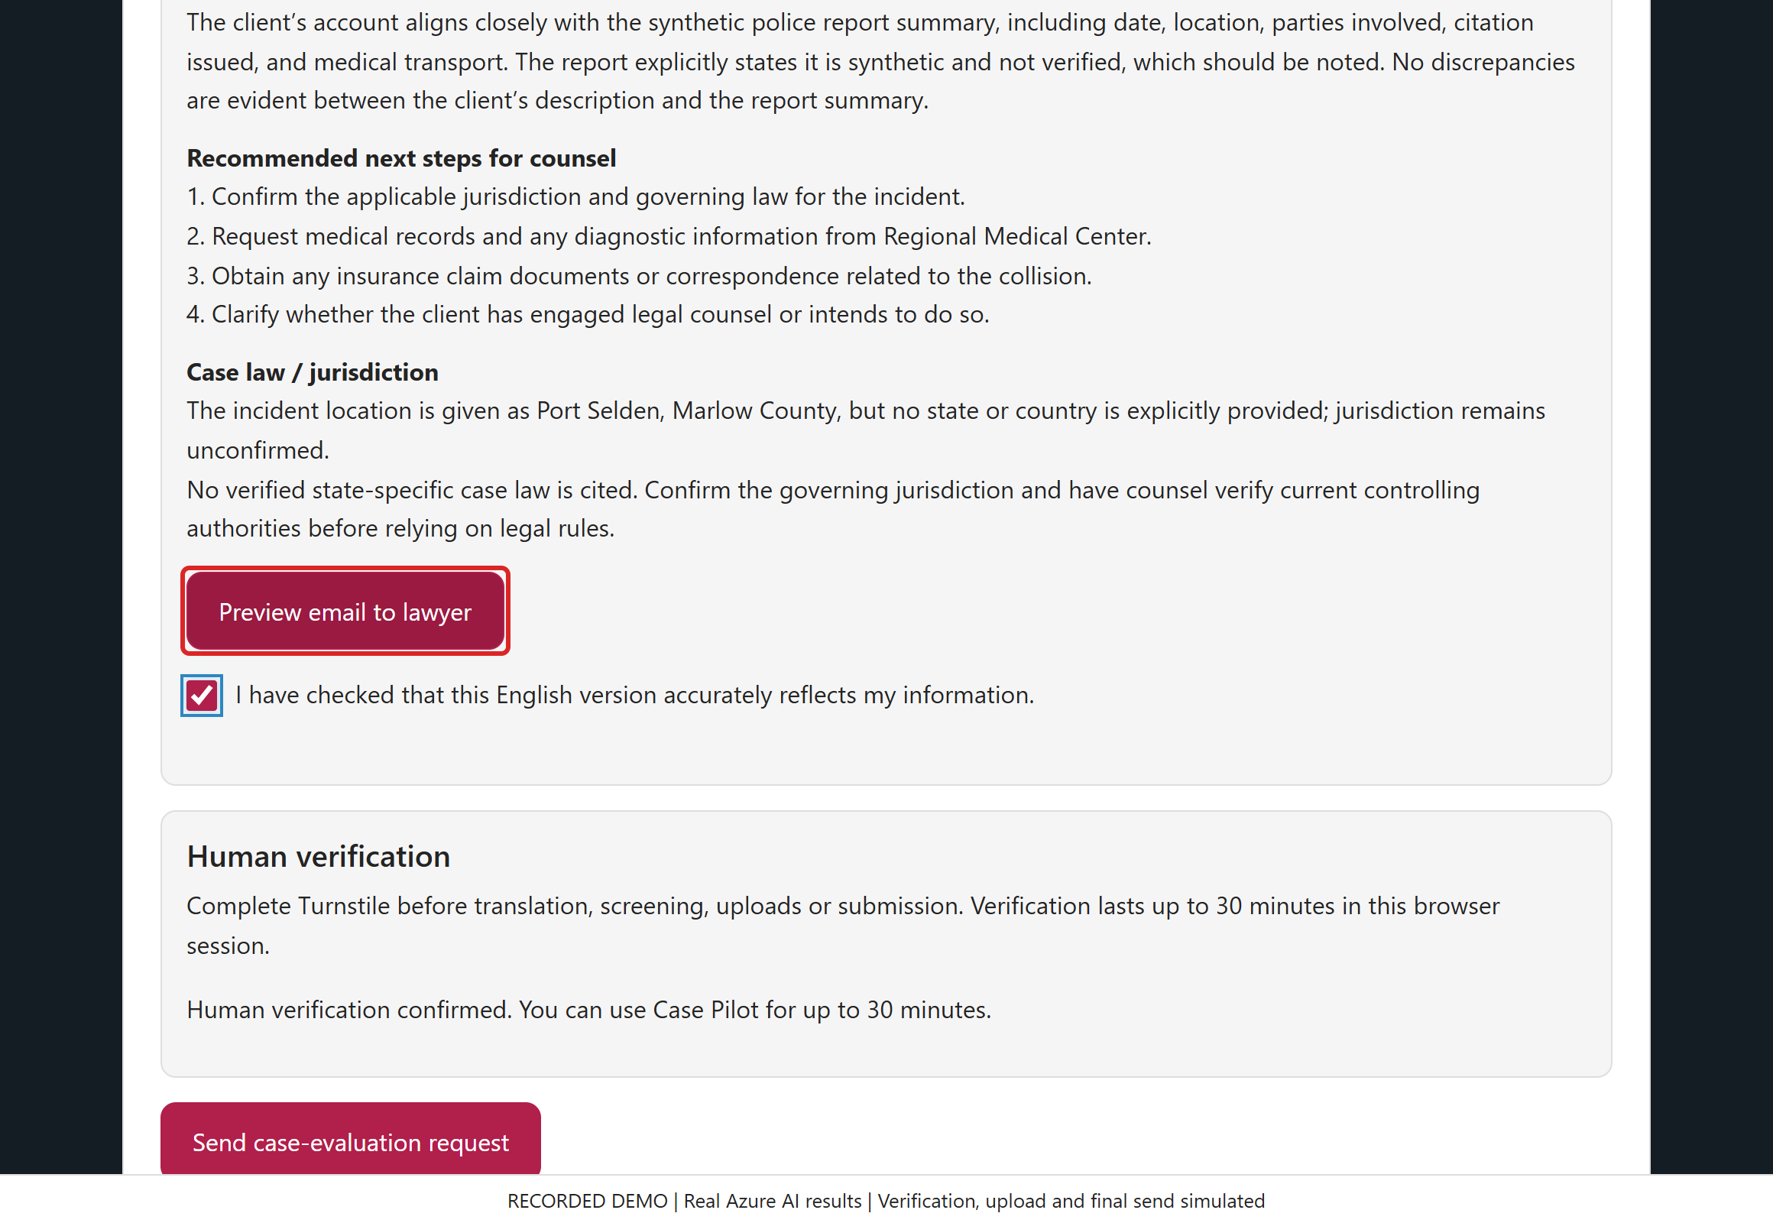
/ CASEPILOT DEMO
SCREEN 17 / 25
Preview the complete lawyer handoff
ACTION / INPUT
Click "Preview email to lawyer" to open the complete proposed message.
WHAT HAPPENS / WHY
The draft uses the same server formatter as actual delivery. It contains the combined analysis, report summary, next steps, jurisdiction limitation and original inquiry.
Click Here
VALUE TO A LAW FIRM
A readable handoff reduces copying between systems and lets staff see exactly what the lawyer would receive.
Recorded synthetic demo | Live Azure AI results | Verification, upload and final send simulated
Notes:
SCREEN 17: Preview the complete lawyer handoff
ACTION: Click "Preview email to lawyer" to open the complete proposed message.
WHAT HAPPENS: The draft uses the same server formatter as actual delivery. It contains the combined analysis, report summary, next steps, jurisdiction limitation and original inquiry.
VALUE TO A LAW FIRM: A readable handoff reduces copying between systems and lets staff see exactly what the lawyer would receive.
Opening this popup does not consume the source allowance, save SQL or send email. Draft timestamps and confirmation metadata are explicitly labeled.
DEMO INTEGRITY: Local rejections use the real form JavaScript. AI fiction rejection, inquiry approval, summary and report classification are actual Azure outcomes captured 2026-10-22T20:01:04.6941892+00:00. UI processing replays those outcomes. Human verification, file transfer/malware scanning and final submission are simulated. No customer request, SQL record or email is created. All people and reports are fictional. Screening is not truth verification, legal advice, case acceptance or proof of report authenticity.

Slide 18
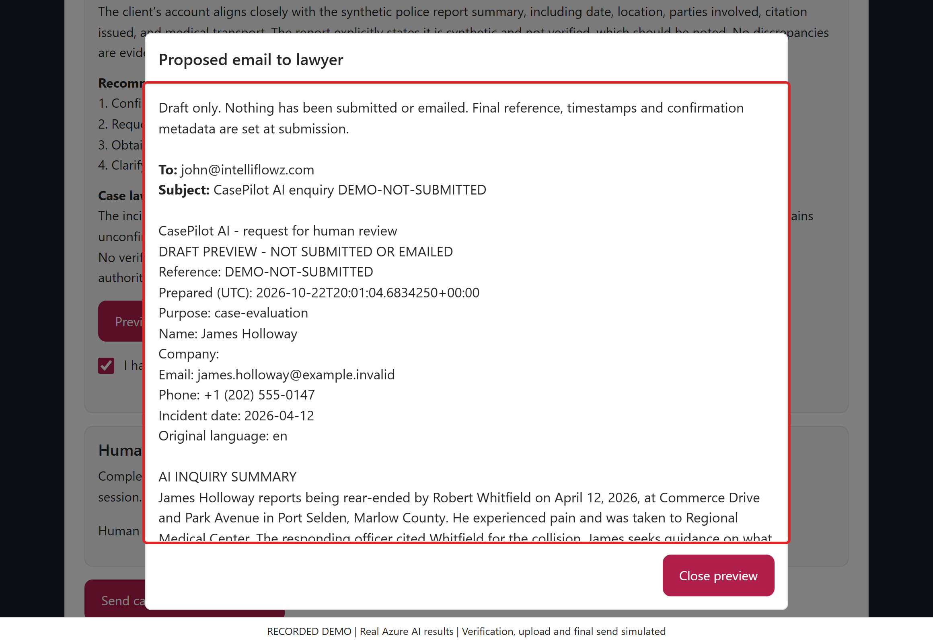
/ CASEPILOT DEMO
SCREEN 18 / 25
Preview the email: inquiry summary
ACTION / INPUT
Read the destination, draft status, reference and AI inquiry summary. Continue through the same complete message.
WHAT HAPPENS / WHY
The actual delivery formatter supplies this content. Draft labels distinguish a preview from a saved submission or delivered email.
VALUE TO A LAW FIRM
Give staff a consistent handoff without copying AI output between applications.
Click Here
Recorded synthetic demo | Live Azure AI results | Verification, upload and final send simulated
Notes:
SCREEN 18: Preview the email: inquiry summary
ACTION: Read the destination, draft status, reference and AI inquiry summary. Continue through the same complete message.
WHAT HAPPENS: The actual delivery formatter supplies this content. Draft labels distinguish a preview from a saved submission or delivered email.
VALUE TO A LAW FIRM: Give staff a consistent handoff without copying AI output between applications.
FULL EMAIL: Part 1. Overlapping scroll captures preserve every line, including original input and concise audit metadata. The sample names no real state/country, so no related case is invented.
COMPLETE PROPOSED EMAIL (NOT SENT)
To: john@intelliflowz.com
Subject: CasePilot AI enquiry DEMO-NOT-SUBMITTED
CasePilot AI - request for human review
DRAFT PREVIEW - NOT SUBMITTED OR EMAILED
Reference: DEMO-NOT-SUBMITTED
Prepared (UTC): 2026-10-22T20:01:04.6834250+00:00
Purpose: case-evaluation
Name: James Holloway
Company:
Email: james.holloway@example.invalid
Phone: +1 (202) 555-0147
Incident date: 2026-04-12
Original language: en
AI INQUIRY SUMMARY
James Holloway reports being rear-ended by Robert Whitfield on April 12, 2026, at Commerce Drive and Park Avenue in Port Selden, Marlow County. He experienced pain and was taken to Regional Medical Center. The responding officer cited Whitfield for the collision. James seeks guidance on what documents a personal injury lawyer needs to review his case.
REPORTED KEY FACTS
- Incident occurred on April 12, 2026, at Commerce Drive and Park Avenue, Port Selden, Marlow County.
- James Holloway was stopped in traffic when Robert Whitfield rear-ended his Jeep Cherokee.
- James experienced pain and was transported to Regional Medical Center after the collision.
- The responding officer issued a citation to Robert Whitfield for failure to control vehicle/failure to yield.
- The police report notes the collision happened at approximately 8:30 PM with clear weather and a 45 mph speed limit.
- Witness Priya Castillo provided a statement consistent with the reported facts.
- Both parties exchanged information at the scene.
- James has not provided any diagnosis or treatment records related to his injuries.
- James is seeking information on what documents a personal injury lawyer requires to review his situation.
- The police report is synthetic and not verified as real-world evidence.
INTAKE VALIDITY / LIMITATIONS
The report describes a rear-end collision with a citation issued to the other driver and a complaint of pain by the client. The facts appear internally consistent and plausible but are based on unverified and synthetic data. No medical diagnosis or treatment records are provided, limiting assessment of injury severity or legal merit.
Plausibility and screening are not verification of truth, identity, authenticity or legal merit.
Immediate danger/medical need reported: False
SCREENED REPORT SUMMARY
PR-001.pdf (police): Synthetic sample report; not verified real-world evidence. On April 12, 2026, at 8:30 PM, a traffic collision occurred at 4402 Commerce Dr at Park Ave, Port Selden, Marlow County. Robert Whitfield rear-ended James Holloway's stopped Jeep Cherokee at an estimated speed of 25 mph. Weather was clear and the speed limit was 45 mph. One person complained of pain and was taken to Regional Medical Center. Witness Priya Castillo provided a consistent statement. Robert Whitfield was cited for failure to control vehicle/failure to yield. Both parties exchanged information.
Private reports are not attached or exposed through public links. Screening does not prove authenticity.
ACCOUNT / REPORT COMPARISON
The client’s account aligns closely with the synthetic police report summary, including date, location, parties involved, citation issued, and medical transport. The report explicitly states it is synthetic and not verified, which should be noted. No discrepancies are evident between the client’s description and the report summary.
RECOMMENDED NEXT STEPS FOR COUNSEL
1. Confirm the applicable jurisdiction and governing law for the incident.
2. Request medical records and any diagnostic information from Regional Medical Center.
3. Obtain any insurance claim documents or correspondence related to the collision.
4. Clarify whether the client has engaged legal counsel or intends to do so.
CASE LAW / JURISDICTION
The incident location is given as Port Selden, Marlow County, but no state or country is explicitly provided; jurisdiction remains unconfirmed.
No verified state-specific case law is cited. Confirm the governing jurisdiction and have counsel verify current controlling authorities before relying on legal rules.
MISSING INFORMATION / FOLLOW-UP
- Specific medical diagnosis and treatment details following the transport to Regional Medical Center.
- Exact nature and extent of James Holloway's injuries beyond reported pain.
- Whether James has retained or contacted any legal counsel prior to this inquiry.
- Details about any insurance claims filed or communications with insurance companies.
- Clarification on whether James has any prior medical conditions relevant to the injury claim.
- Confirmation of the jurisdiction or governing law beyond the city and county names provided.
COMPLETE ENGLISH INTAKE
name: James Holloway
company:
email: james.holloway@example.invalid
phone: +1 (202) 555-0147
location: Port Selden, Marlow County
description: On April 12, 2026, I was stopped in traffic at Commerce Drive and Park Avenue in Port Selden when Robert Whitfield's Toyota struck the rear of my Jeep. I experienced pain and was transported to Regional Medical Center. The responding officer issued the other driver a citation. I would like help understanding what documents a personal injury lawyer needs to review my situation.
injuries: I experienced pain after the collision and was transported to Regional Medical Center. I have not provided a diagnosis or treatment records.
ORIGINAL INQUIRY
Location of matter: Port Selden, Marlow County
On April 12, 2026, I was stopped in traffic at Commerce Drive and Park Avenue in Port Selden when Robert Whitfield's Toyota struck the rear of my Jeep. I experienced pain and was transported to Regional Medical Center. The responding officer issued the other driver a citation. I would like help understanding what documents a personal injury lawyer needs to review my situation.
Additional details: I experienced pain after the collision and was transported to Regional Medical Center. I have not provided a diagnosis or treatment records.
AUDIT METADATA
Visitor IP: 192.0.2.10
Visitor location: Not collected (not-collected)
Source host: demo.example.invalid
Consent: True; English confirmed: Required before submission; Policy: casepilot-v5
Input/output/total tokens: 4894/994/5888
Completion calls: 6
Full original fields, structured analysis and provider usage are retained in the private submission record after successful submission.
This is an AI-screened enquiry, not legal advice, case acceptance or a completed conflict check.
No representation, deadline protection, assigned attorney or callback has been promised.
DEMO INTEGRITY: Local rejections use the real form JavaScript. AI fiction rejection, inquiry approval, summary and report classification are actual Azure outcomes captured 2026-10-22T20:01:04.6941892+00:00. UI processing replays those outcomes. Human verification, file transfer/malware scanning and final submission are simulated. No customer request, SQL record or email is created. All people and reports are fictional. Screening is not truth verification, legal advice, case acceptance or proof of report authenticity.

Slide 19
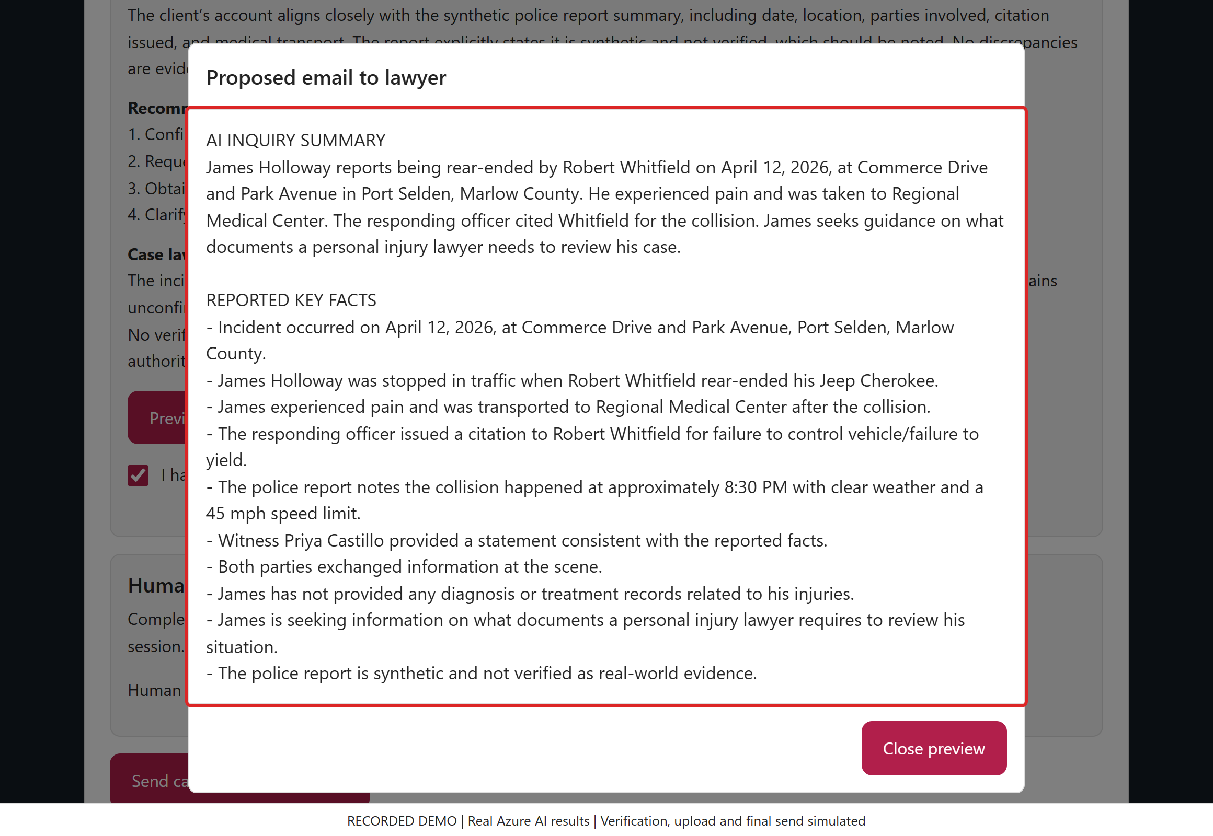
/ CASEPILOT DEMO
SCREEN 19 / 25
Review reported facts and validity
ACTION / INPUT
Read the reported key facts and the plausibility assessment. They remain reported facts, not verified truth.
WHAT HAPPENS / WHY
The combined analysis does not authenticate the report, prove identity, diagnose injury or determine legal merit.
VALUE TO A LAW FIRM
Separate the person's account from assumptions and make verification limits visible to the lawyer.
Click Here
Recorded synthetic demo | Live Azure AI results | Verification, upload and final send simulated
Notes:
SCREEN 19: Review reported facts and validity
ACTION: Read the reported key facts and the plausibility assessment. They remain reported facts, not verified truth.
WHAT HAPPENS: The combined analysis does not authenticate the report, prove identity, diagnose injury or determine legal merit.
VALUE TO A LAW FIRM: Separate the person's account from assumptions and make verification limits visible to the lawyer.
FULL EMAIL: Part 2. Overlapping scroll captures preserve every line, including original input and concise audit metadata. The sample names no real state/country, so no related case is invented.
The complete proposed email is also preserved in the first email-preview slide's speaker notes and in the website's full-text popup/download.
DEMO INTEGRITY: Local rejections use the real form JavaScript. AI fiction rejection, inquiry approval, summary and report classification are actual Azure outcomes captured 2026-10-22T20:01:04.6941892+00:00. UI processing replays those outcomes. Human verification, file transfer/malware scanning and final submission are simulated. No customer request, SQL record or email is created. All people and reports are fictional. Screening is not truth verification, legal advice, case acceptance or proof of report authenticity.

Slide 20
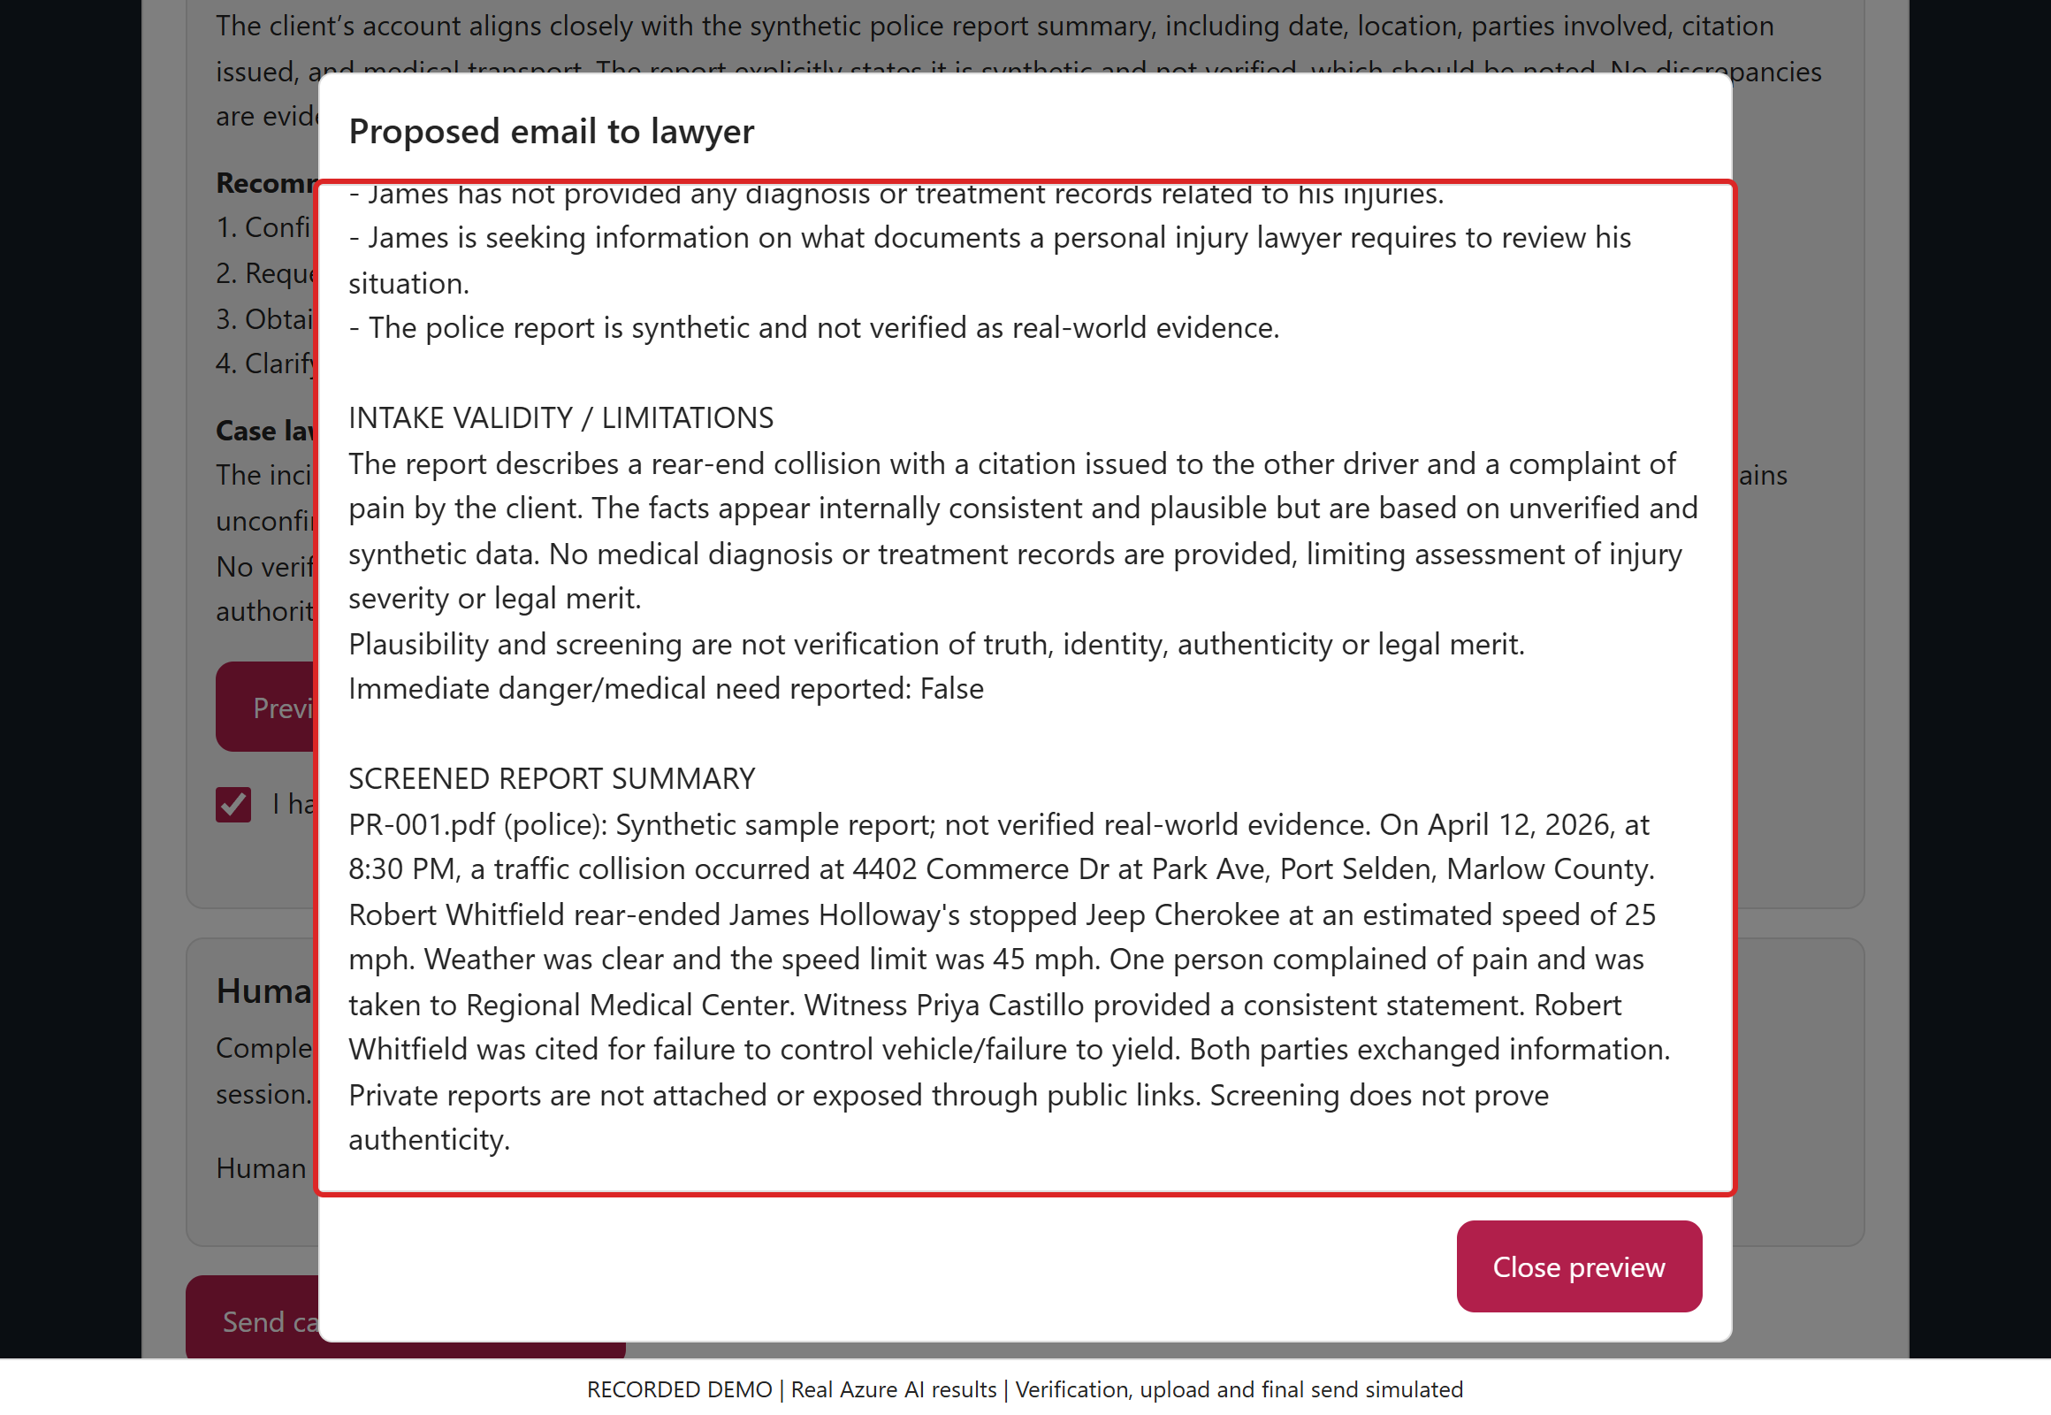
/ CASEPILOT DEMO
SCREEN 20 / 25
Read the report summary and comparison
ACTION / INPUT
Read the police-report summary and compare it with the account. Continue for the complete comparison.
WHAT HAPPENS / WHY
PR-001 is explicitly synthetic. Its witness and citation details are reported evidence, not a final finding of civil liability.
VALUE TO A LAW FIRM
Reduce initial reading time while keeping the source report and important evidence limits visible.
Click Here
Recorded synthetic demo | Live Azure AI results | Verification, upload and final send simulated
Notes:
SCREEN 20: Read the report summary and comparison
ACTION: Read the police-report summary and compare it with the account. Continue for the complete comparison.
WHAT HAPPENS: PR-001 is explicitly synthetic. Its witness and citation details are reported evidence, not a final finding of civil liability.
VALUE TO A LAW FIRM: Reduce initial reading time while keeping the source report and important evidence limits visible.
FULL EMAIL: Part 3. Overlapping scroll captures preserve every line, including original input and concise audit metadata. The sample names no real state/country, so no related case is invented.
The complete proposed email is also preserved in the first email-preview slide's speaker notes and in the website's full-text popup/download.
DEMO INTEGRITY: Local rejections use the real form JavaScript. AI fiction rejection, inquiry approval, summary and report classification are actual Azure outcomes captured 2026-10-22T20:01:04.6941892+00:00. UI processing replays those outcomes. Human verification, file transfer/malware scanning and final submission are simulated. No customer request, SQL record or email is created. All people and reports are fictional. Screening is not truth verification, legal advice, case acceptance or proof of report authenticity.

Slide 21
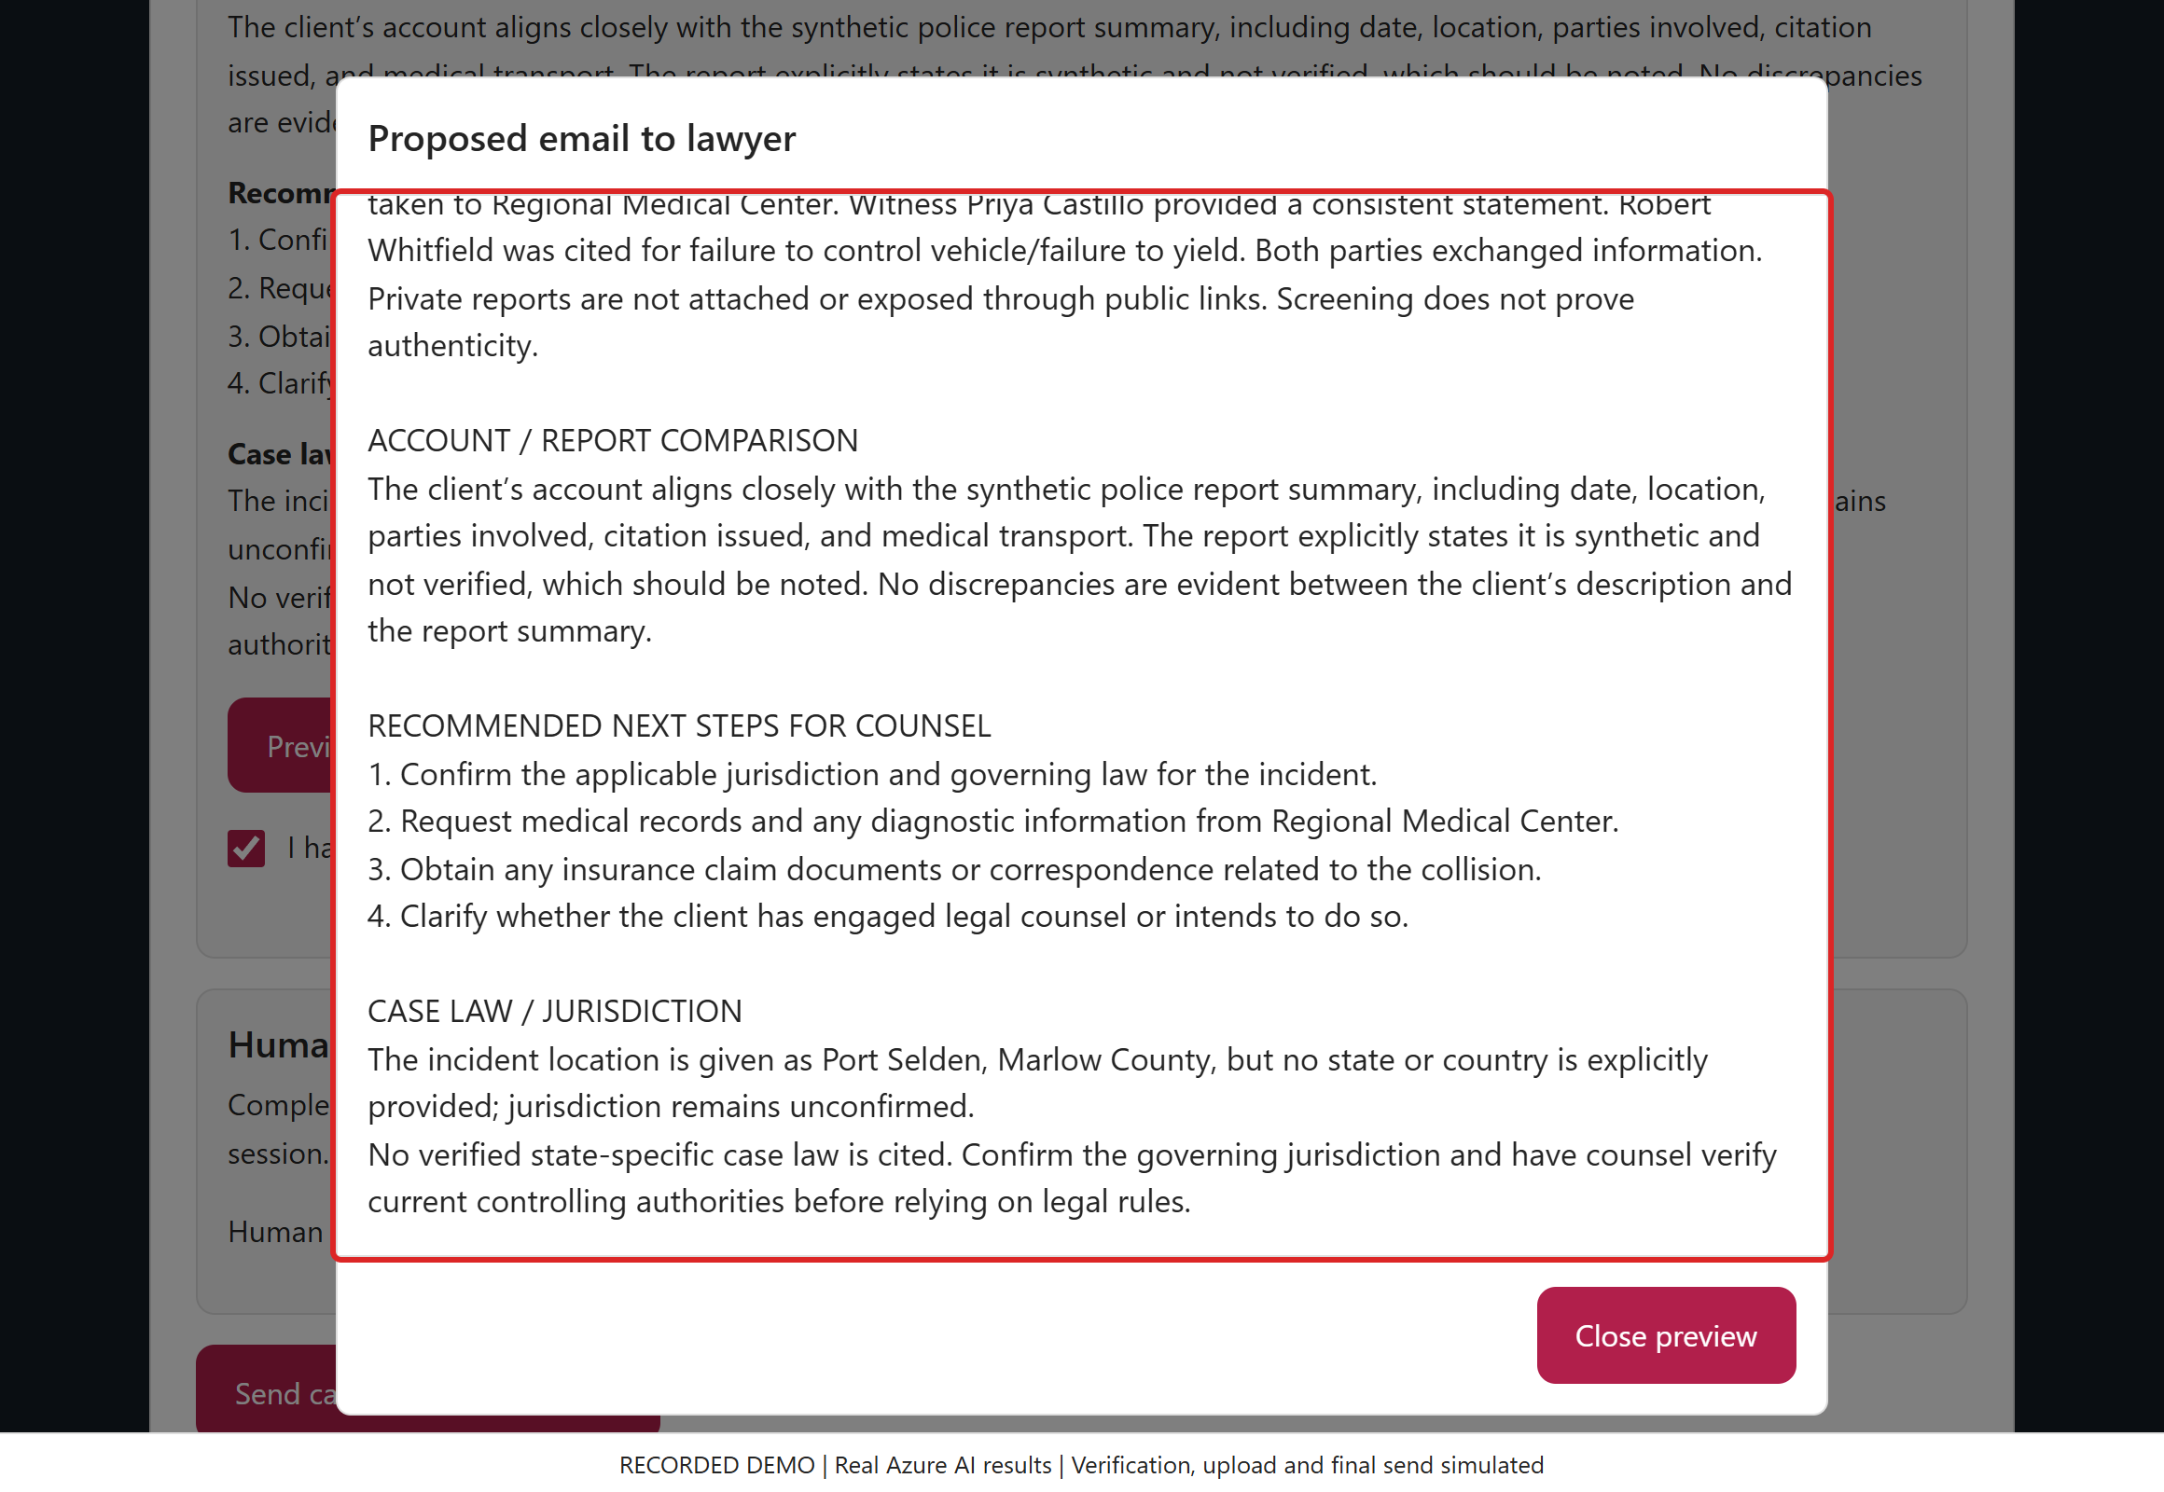
/ CASEPILOT DEMO
SCREEN 21 / 25
Review next steps and case-law limits
ACTION / INPUT
Read the comparison, four next steps and short jurisdiction note. Follow-up questions continue on the next screen.
WHAT HAPPENS / WHY
No real state or country is named. The analysis invents no cases; counsel must confirm jurisdiction and verify controlling authorities.
VALUE TO A LAW FIRM
Turn the narrative into focused follow-up tasks without flooding the lawyer with speculative legal research.
Click Here
Recorded synthetic demo | Live Azure AI results | Verification, upload and final send simulated
Notes:
SCREEN 21: Review next steps and case-law limits
ACTION: Read the comparison, four next steps and short jurisdiction note. Follow-up questions continue on the next screen.
WHAT HAPPENS: No real state or country is named. The analysis invents no cases; counsel must confirm jurisdiction and verify controlling authorities.
VALUE TO A LAW FIRM: Turn the narrative into focused follow-up tasks without flooding the lawyer with speculative legal research.
FULL EMAIL: Part 4. Overlapping scroll captures preserve every line, including original input and concise audit metadata. The sample names no real state/country, so no related case is invented.
The complete proposed email is also preserved in the first email-preview slide's speaker notes and in the website's full-text popup/download.
DEMO INTEGRITY: Local rejections use the real form JavaScript. AI fiction rejection, inquiry approval, summary and report classification are actual Azure outcomes captured 2026-10-22T20:01:04.6941892+00:00. UI processing replays those outcomes. Human verification, file transfer/malware scanning and final submission are simulated. No customer request, SQL record or email is created. All people and reports are fictional. Screening is not truth verification, legal advice, case acceptance or proof of report authenticity.

Slide 22
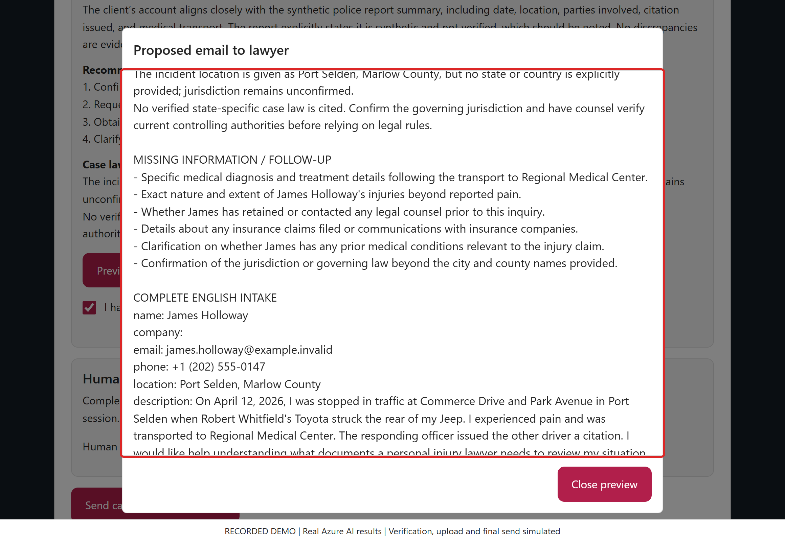
/ CASEPILOT DEMO
SCREEN 22 / 25
Preserve the complete original inquiry
ACTION / INPUT
Read the remaining follow-up questions and complete English/original inquiry. Continue for the audit and final limitations.
WHAT HAPPENS / WHY
The original account is preserved separately from AI interpretation so the lawyer can compare the handoff with the person's actual words.
VALUE TO A LAW FIRM
Reduce transcription mistakes and make missing records easier to request.
Click Here
Recorded synthetic demo | Live Azure AI results | Verification, upload and final send simulated
Notes:
SCREEN 22: Preserve the complete original inquiry
ACTION: Read the remaining follow-up questions and complete English/original inquiry. Continue for the audit and final limitations.
WHAT HAPPENS: The original account is preserved separately from AI interpretation so the lawyer can compare the handoff with the person's actual words.
VALUE TO A LAW FIRM: Reduce transcription mistakes and make missing records easier to request.
FULL EMAIL: Part 5. Overlapping scroll captures preserve every line, including original input and concise audit metadata. The sample names no real state/country, so no related case is invented.
The complete proposed email is also preserved in the first email-preview slide's speaker notes and in the website's full-text popup/download.
DEMO INTEGRITY: Local rejections use the real form JavaScript. AI fiction rejection, inquiry approval, summary and report classification are actual Azure outcomes captured 2026-10-22T20:01:04.6941892+00:00. UI processing replays those outcomes. Human verification, file transfer/malware scanning and final submission are simulated. No customer request, SQL record or email is created. All people and reports are fictional. Screening is not truth verification, legal advice, case acceptance or proof of report authenticity.

Slide 23
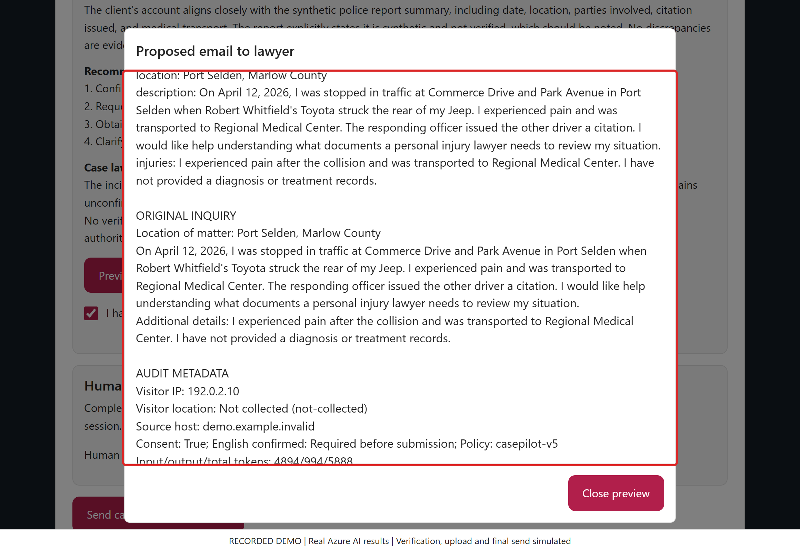
/ CASEPILOT DEMO
SCREEN 23 / 25
Compare original and English accounts
ACTION / INPUT
Read the rest of the approved English account and the original inquiry. Continue to the final audit and disclaimers.
WHAT HAPPENS / WHY
Translation and AI interpretation never overwrite the original facts entered by the person. Both accounts remain in the handoff.
VALUE TO A LAW FIRM
Preserve context and let the lawyer identify misunderstandings without reconstructing the intake.
Click Here
Recorded synthetic demo | Live Azure AI results | Verification, upload and final send simulated
Notes:
SCREEN 23: Compare original and English accounts
ACTION: Read the rest of the approved English account and the original inquiry. Continue to the final audit and disclaimers.
WHAT HAPPENS: Translation and AI interpretation never overwrite the original facts entered by the person. Both accounts remain in the handoff.
VALUE TO A LAW FIRM: Preserve context and let the lawyer identify misunderstandings without reconstructing the intake.
FULL EMAIL: Part 6. Overlapping scroll captures preserve every line, including original input and concise audit metadata. The sample names no real state/country, so no related case is invented.
The complete proposed email is also preserved in the first email-preview slide's speaker notes and in the website's full-text popup/download.
DEMO INTEGRITY: Local rejections use the real form JavaScript. AI fiction rejection, inquiry approval, summary and report classification are actual Azure outcomes captured 2026-10-22T20:01:04.6941892+00:00. UI processing replays those outcomes. Human verification, file transfer/malware scanning and final submission are simulated. No customer request, SQL record or email is created. All people and reports are fictional. Screening is not truth verification, legal advice, case acceptance or proof of report authenticity.

Slide 24
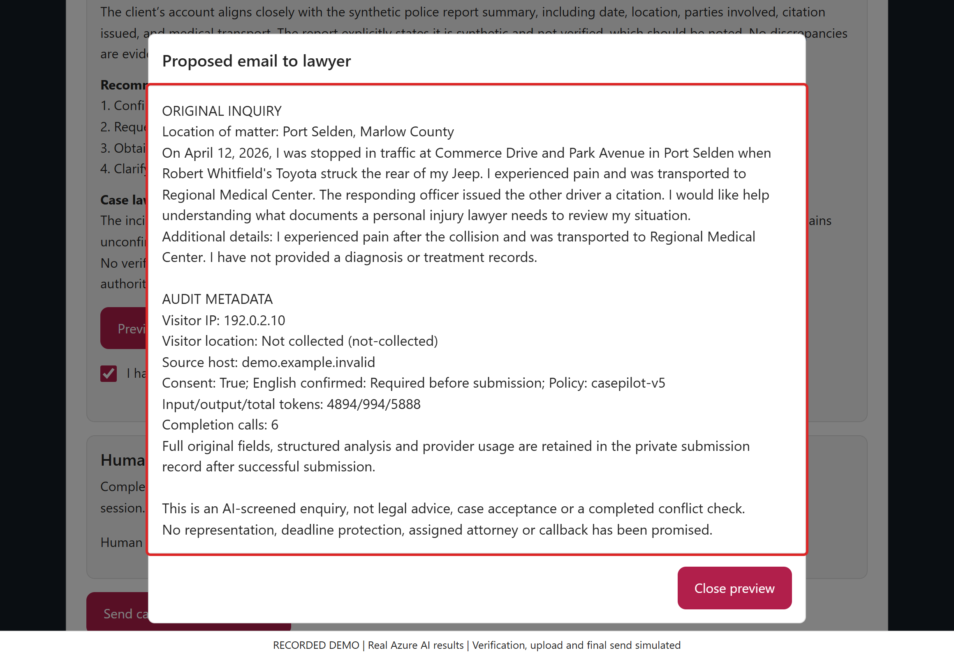
/ CASEPILOT DEMO
SCREEN 24 / 25
Finish with an auditable draft
ACTION / INPUT
Read the remaining original details, source/usage metadata and disclaimers. Close the preview before the final simulated send.
WHAT HAPPENS / WHY
No SQL row or email was created here. Production submission saves the complete analysis before activating its durable email outbox.
VALUE TO A LAW FIRM
Keep intake receipt, delivery and legal acceptance distinct, with a concise audit trail.
Click Here
Recorded synthetic demo | Live Azure AI results | Verification, upload and final send simulated
Notes:
SCREEN 24: Finish with an auditable draft
ACTION: Read the remaining original details, source/usage metadata and disclaimers. Close the preview before the final simulated send.
WHAT HAPPENS: No SQL row or email was created here. Production submission saves the complete analysis before activating its durable email outbox.
VALUE TO A LAW FIRM: Keep intake receipt, delivery and legal acceptance distinct, with a concise audit trail.
FULL EMAIL: Part 7. Overlapping scroll captures preserve every line, including original input and concise audit metadata. The sample names no real state/country, so no related case is invented.
The complete proposed email is also preserved in the first email-preview slide's speaker notes and in the website's full-text popup/download.
DEMO INTEGRITY: Local rejections use the real form JavaScript. AI fiction rejection, inquiry approval, summary and report classification are actual Azure outcomes captured 2026-10-22T20:01:04.6941892+00:00. UI processing replays those outcomes. Human verification, file transfer/malware scanning and final submission are simulated. No customer request, SQL record or email is created. All people and reports are fictional. Screening is not truth verification, legal advice, case acceptance or proof of report authenticity.

Slide 25
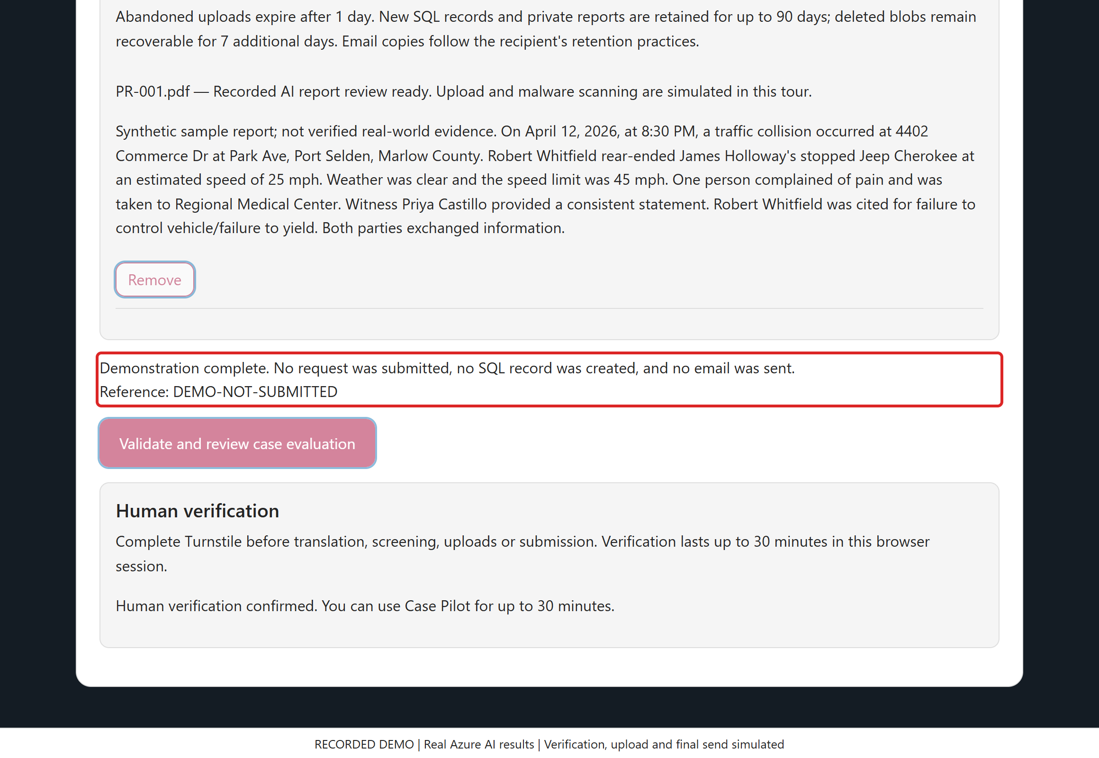
/ CASEPILOT DEMO
SCREEN 25 / 25
Finish with an honest demo receipt
ACTION / INPUT
Read the explicit simulated receipt. In the walkthrough, use Click Here to restart or the page controls to revisit a step.
WHAT HAPPENS / WHY
The reference is DEMO-NOT-SUBMITTED. No SQL inquiry, live storage upload or notification email was created.
VALUE TO A LAW FIRM
A clear receipt distinguishes technical workflow completion from inbox delivery, attorney review and actual case acceptance.
Click Here
Recorded synthetic demo | Live Azure AI results | Verification, upload and final send simulated
Notes:
SCREEN 25: Finish with an honest demo receipt
ACTION: Read the explicit simulated receipt. In the walkthrough, use Click Here to restart or the page controls to revisit a step.
WHAT HAPPENS: The reference is DEMO-NOT-SUBMITTED. No SQL inquiry, live storage upload or notification email was created.
VALUE TO A LAW FIRM: A clear receipt distinguishes technical workflow completion from inbox delivery, attorney review and actual case acceptance.
Real production success means the submission has been saved; queued/accepted email is not proof of delivery, representation or a callback.
DEMO INTEGRITY: Local rejections use the real form JavaScript. AI fiction rejection, inquiry approval, summary and report classification are actual Azure outcomes captured 2026-10-22T20:01:04.6941892+00:00. UI processing replays those outcomes. Human verification, file transfer/malware scanning and final submission are simulated. No customer request, SQL record or email is created. All people and reports are fictional. Screening is not truth verification, legal advice, case acceptance or proof of report authenticity.

